Slide 1
Town Forest Recreation Plan Presentation
DATE TOWN NAME
Notes:
Are these the right logos?

Slide 2
Project Overview

Slide 3
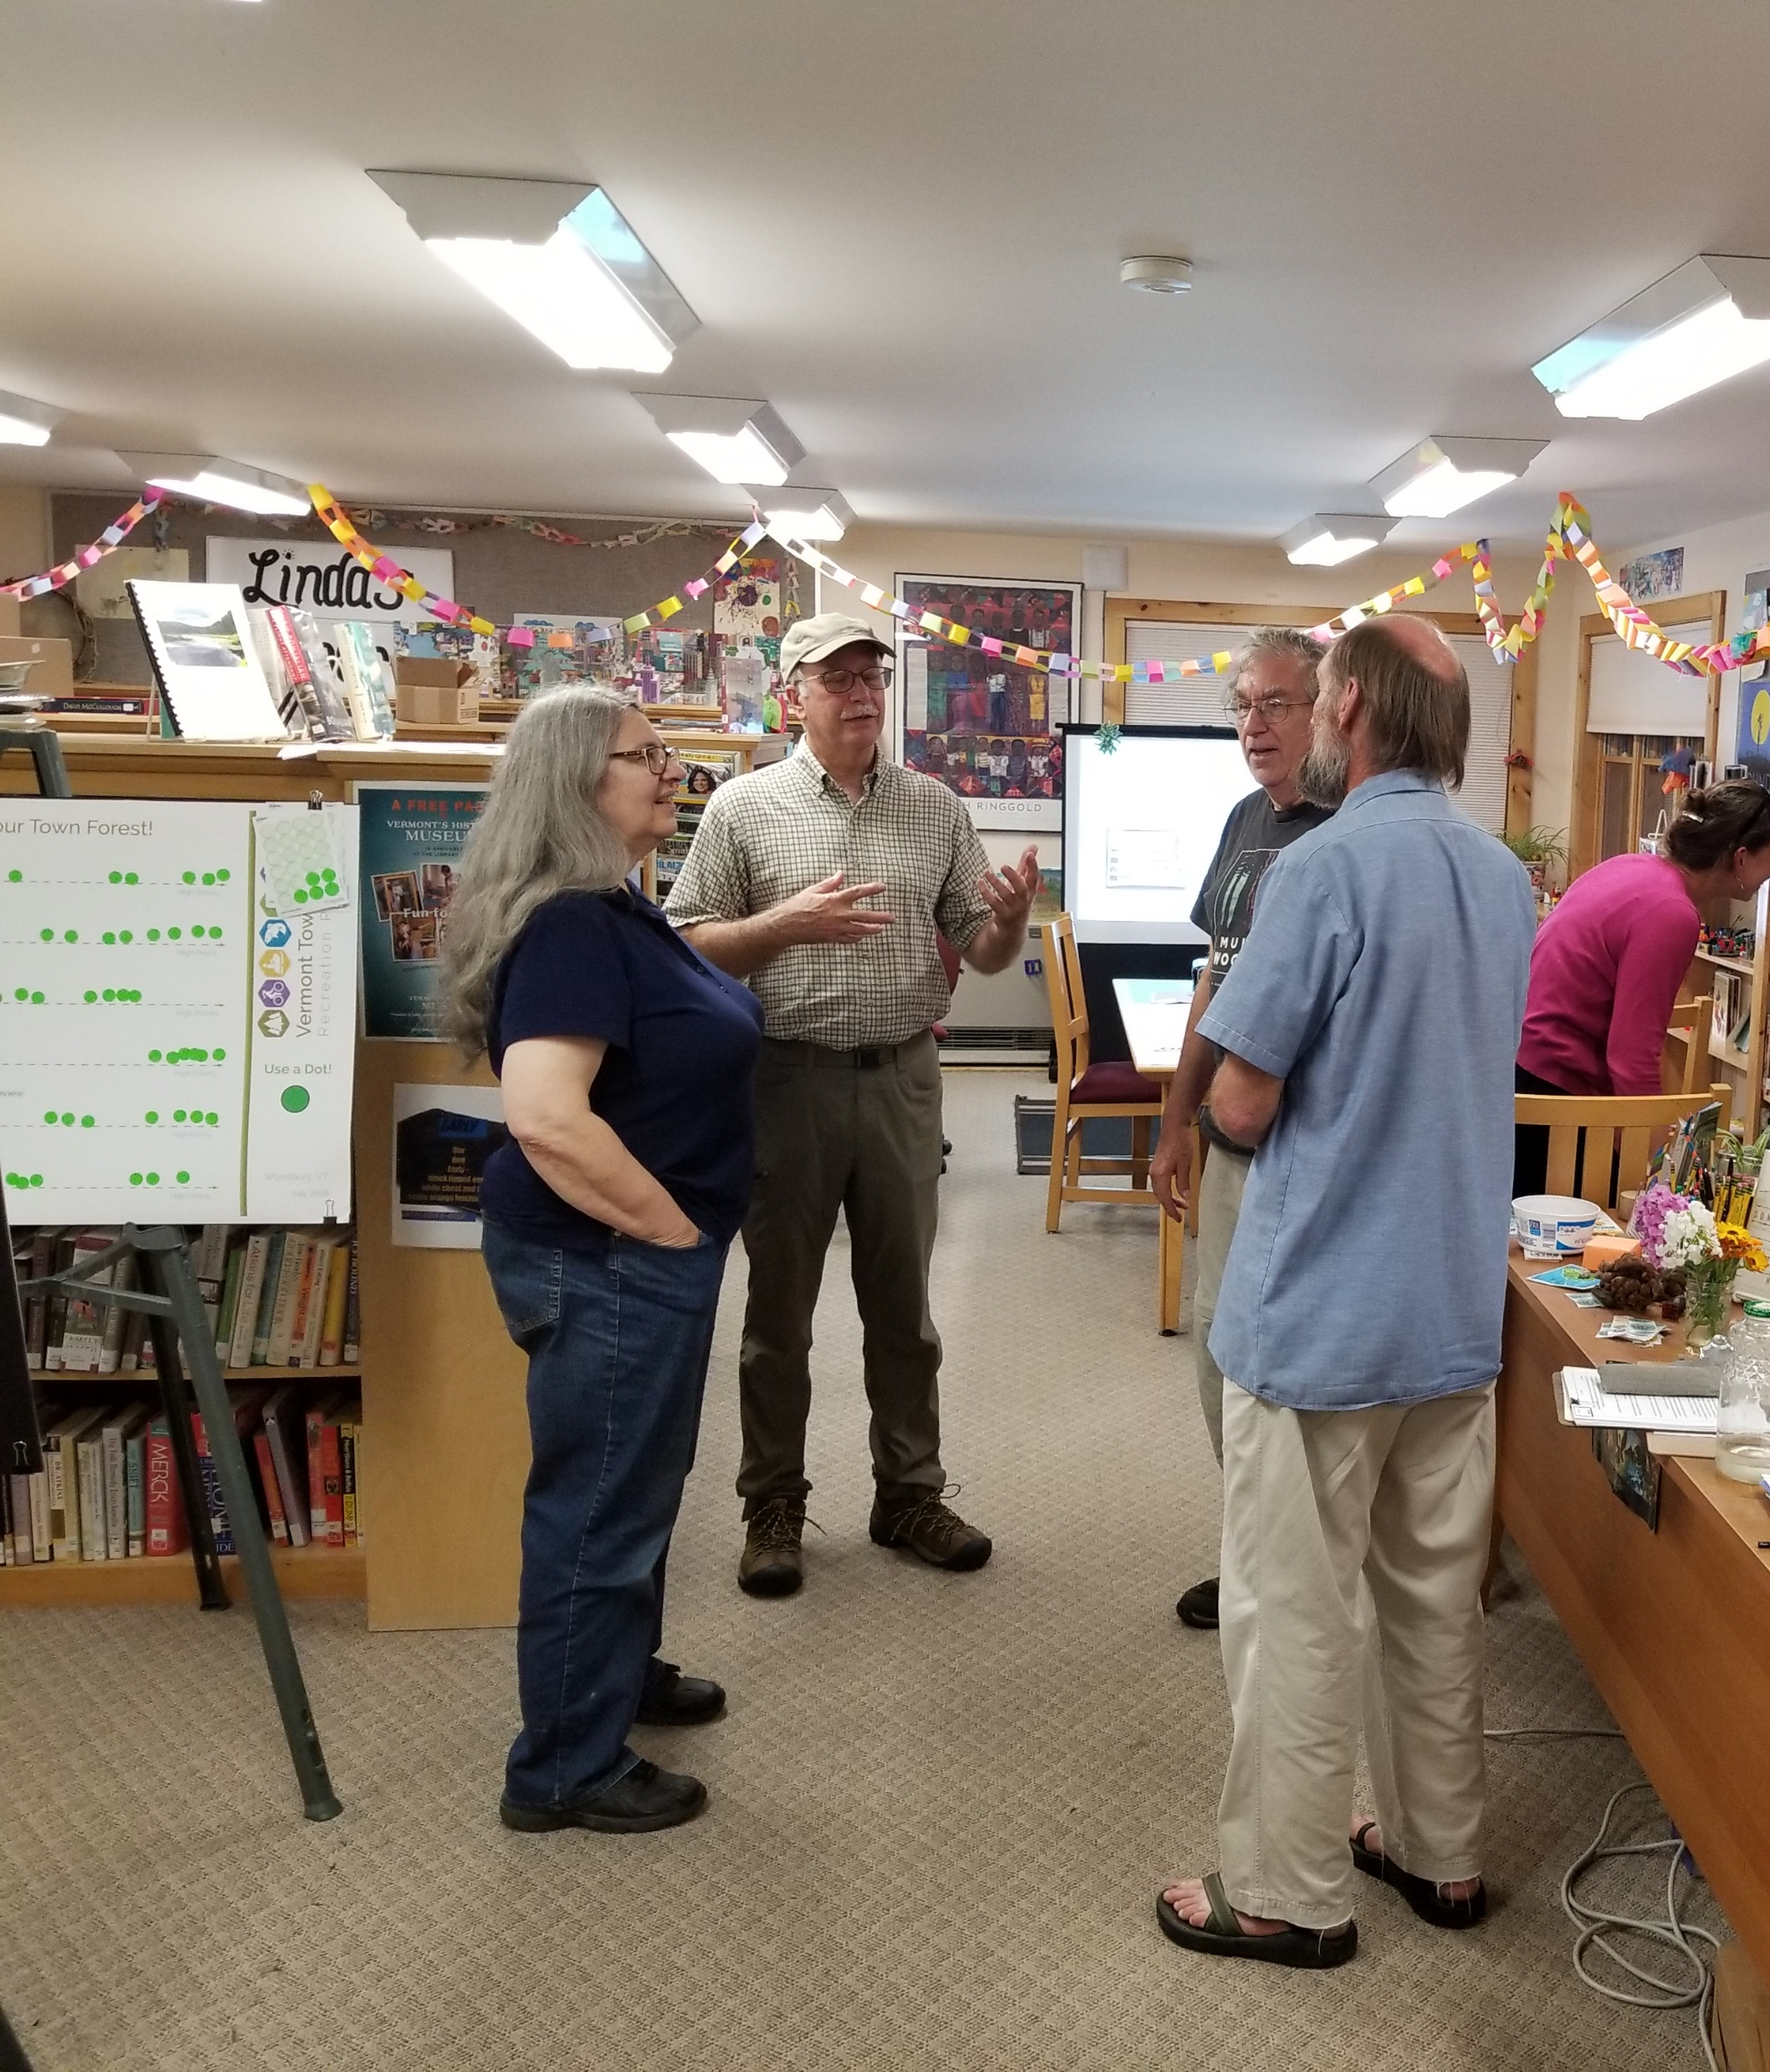
Town Forest Steering Committee
The Local Project Team That Made It All Happen
List of people

Slide 4
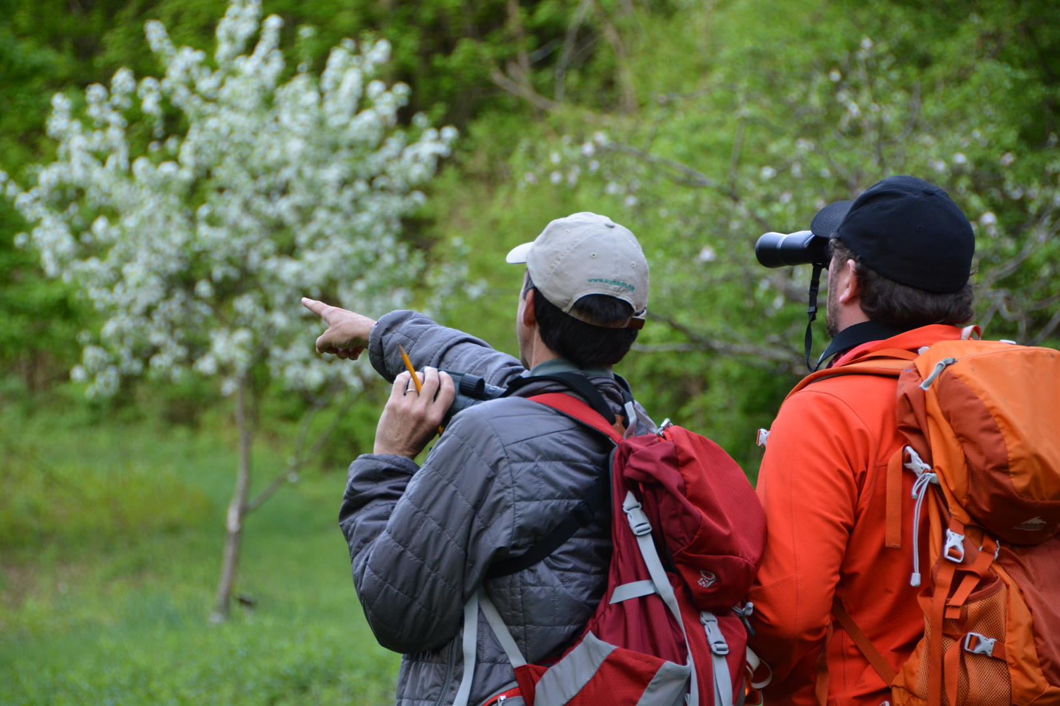
Project Purpose and Scope
Empowering Communities to Move Forward with Confidence in their Town Forest
Three Key Areas:
Developing a compelling and inspiring vision to help guide the future management of the town forest
Developing discrete, clear and action-oriented strategies for improvement of recreation and stewardship that achieves the vision
Fostering implementation with support and guidance on implementation
Notes:
Town forests a such an important part of so many Vermont forests, and we are now starting to wise up to the full picture of how important recreation is in Vermont, it was reconized there was a lack of recreation and stewardship plans in many of vermonts town forests.
So the State and UCF went after this grant from the USFS to bring money to help develop 10 town forest plans in Ver
But when we saw that, we thought we don’t want to just do 10 separate plans and not learn anything through the process, so what we proposed and they have bought into is this idea of developing the town forest recreation planning toolkit as we go through this process which can be used by any Vermont community looking to do a vision and action plan for their town forest..
Which you see up there is the first of four key areas.
Now the toolkit development wont directly involve you guys that much—we are going to be doing all the toolkit materials and facilitating all the meetings with you guys which other Vermont towns wont get--but I want you to be aware of it and understand that aspect of the overall project that we are all working on
I will show some examples in a minute, but the toolkit is essentially all the materials needed to carry out the town forest planning processes we are going to complete with each of you by towns without consultant help.
We’ll be providing instructions, templates, process directions, best practices, tools like trail standards, assessment forms and user counting methods
More on that in just a minute. For now, lets look at the other 3 key areas of the project, which you we will be guiding you through.
Developing a compelling and inspiring vision to help guide the future management of each of the ten selected town forests
Developing discrete, clear and action-oriented strategies for improvement of recreation and stewardship that achieves the vision
Fostering implementation with support for local plan adoption, guidance for implementation, and the Implementation Summit

Slide 5
Public Visioning Workshop
Community Survey
Steering Committee Visioning
Draft Vision Framework for Town Forest
Environmental Considerations & Site Constraints
Develop Range of Strategies to Achieve Vision
Project Schedule
Visioning Workshops: DATE
Community Survey: DATE
Strategies Public Workshop: DATE
Plan Presentation Public Workshop: Today!
Final Plan: DATE
Strategies Workshop:
Review Draft Vision
Select & Prioritize Strategies
Legend
Community Input
Consultant Analysis/ Deliverable
Draft Action Plan
Project Toolkit
You Are Here
Plan Presentation Workshop
Final Plan Document
Construction & Design Standards
Management Best Practices
Implementation Coaching
Funding & Support Resources

Slide 6
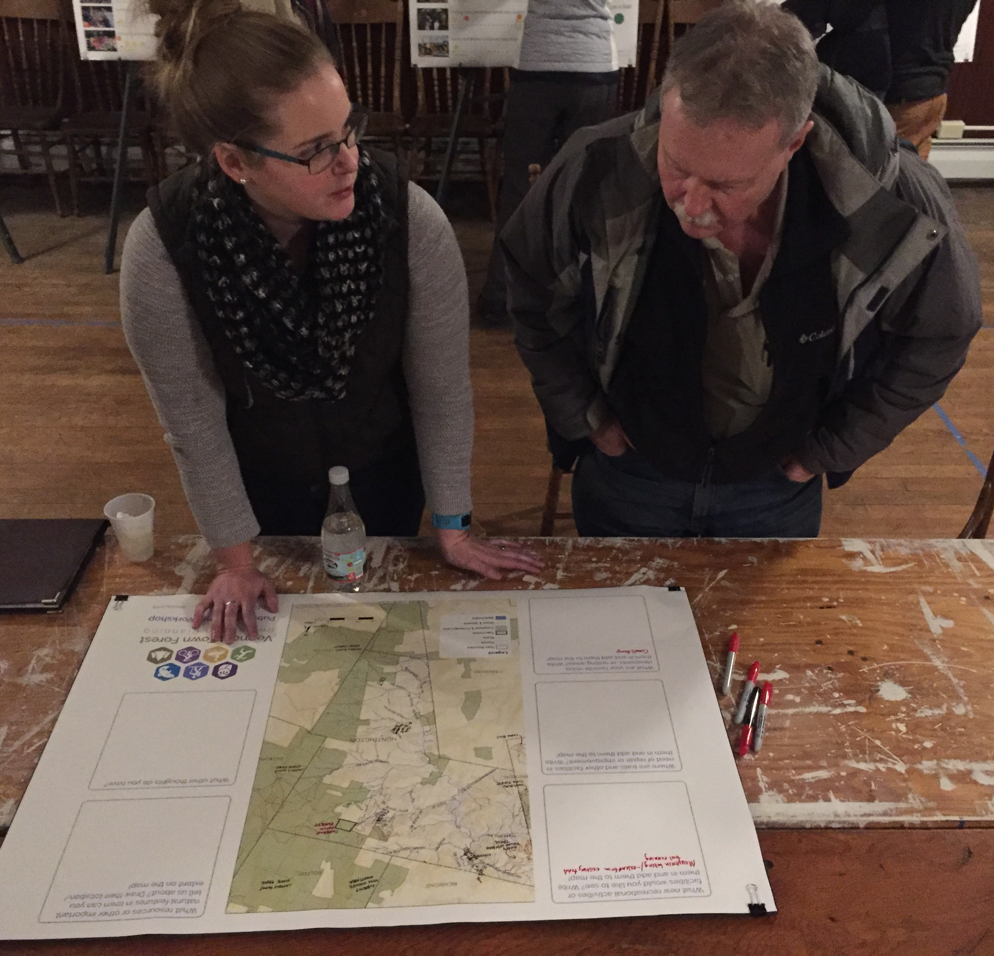
Project Progress
Community Visioning & Draft Strategies
Forest Walk
Identifying areas of ecological and recreational importance in the forest
Steering Committee Meetings
Analysis of Strengths, Weaknesses, Opportunities, and Threats to the forest
Review of concepts, documents, strategies
Public Visioning Workshop
DATE
___ attendees
Questions about a vision, natural resources, activities, programs, and events in the forest
Visioning Survey
___ responses
Available both online and hard copy (Update)
Same questions as the public workshop
Public Draft Strategies Workshop
DATE
___ attendees
Review vision framework and draft strategies
Select and prioritize strategies
This information was taken into account in developing natural resource guidelines, vision framework, and strategies for the forest

Slide 7
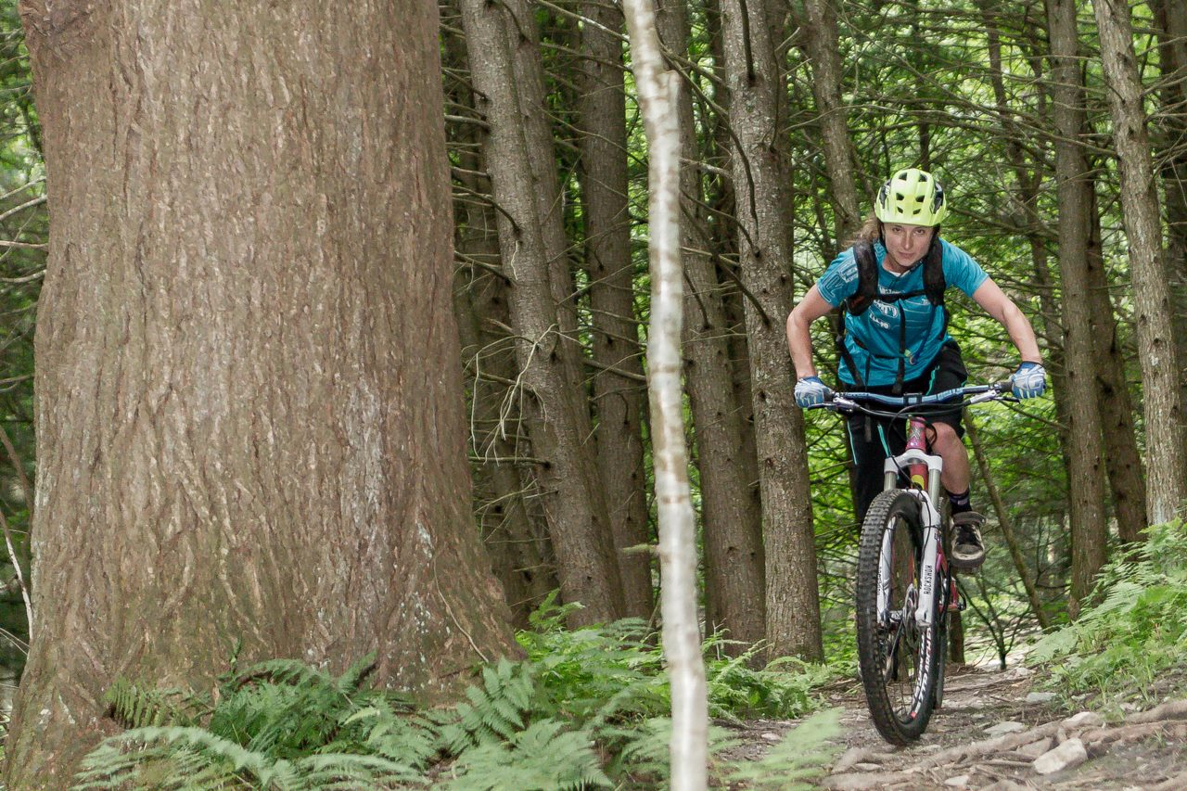
Action Plan Components
Action Plans With Discrete, Clear and Implementable Strategies for Improvement of Recreation
Our Action Plan identifies:
Project description
Action responsibility
Timing (immediate, short, medium, long-term)
Partners involved
How actions relate to each other
Available support resources
Toolkit resources
Funding and grant opportunities
Magnitude of costs ($-$$-$$$-$$$$)
Photo Courtesy of John Atkinson, Mad River Riders
Everything we need to go after grants to implement these projects!
Notes:
Same as january

Slide 8
Recreation Planning Toolkit
Additional resources and information to implement your plan and enable other towns to complete this process
Resources we have received:
Management Zones Toolkit
Grant Writing Best Practices
Sustainable Trail Standards
Pause Places Toolkit
Volunteer Project Designs
Parking Considerations
Toolkit
Trail Counting Forms
Model Process for New Trails
Vtrans Signage Program
Conservation Best Practices
Notes:
The pod info doesn’t seem quite relevant here. The right is some of the things in the implementation pod from the outline. Is the righthand column necessary?

Slide 9
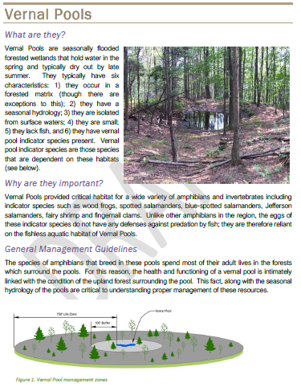
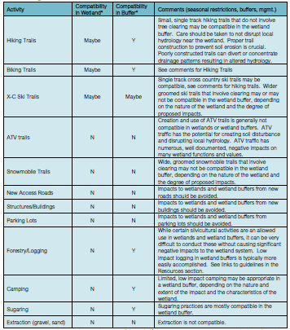
Natural Resources Guidelines
Section about each natural community in the forest: vernal pools, floodplain forests, wetlands, deer wintering areas, etc.
For each, there’s background information, explanation of its importance, general management guidelines, regulatory issues, links to additional resources and guidelines, and a matrix of compatible activities.

Slide 10
Vision Framework

Slide 11
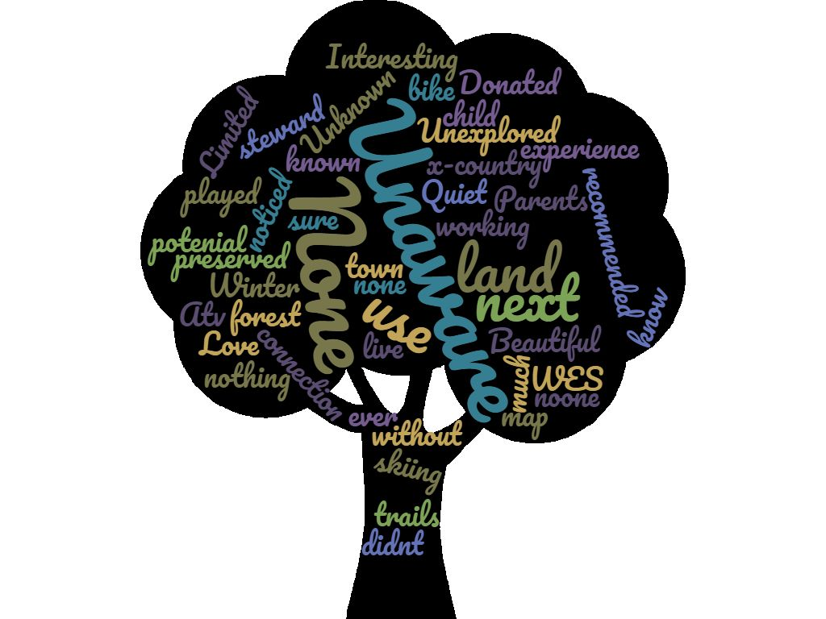
Existing Experiences
What word or phrase best describes your EXISTING experience with our town forest?
Paste in visioning word cloud

Slide 12
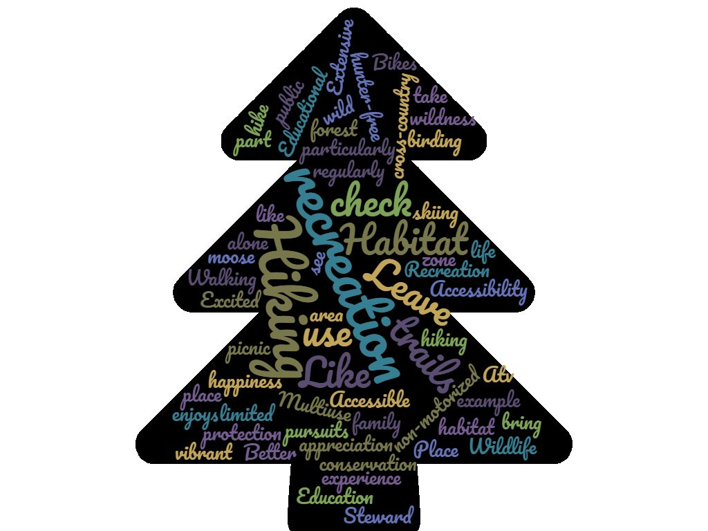
Future Experiences
What word or phrase best describes your DESIRED FUTURE experience with our town forest?
Paste in visioning word cloud

Slide 13
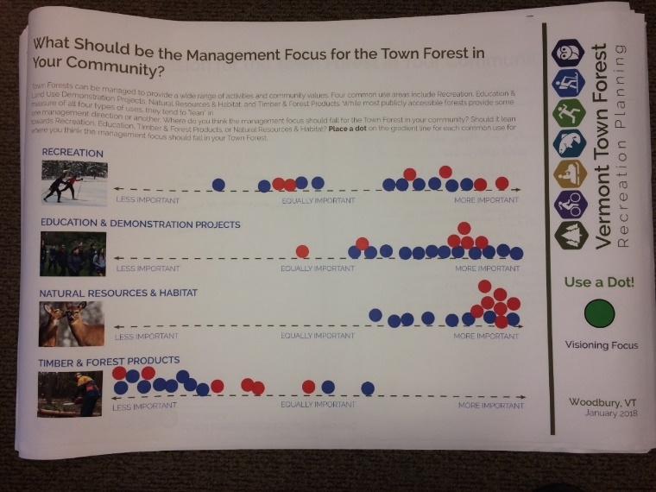
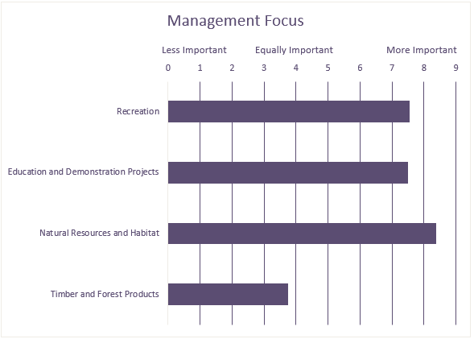
Management Balance
Where should the management focus fall for the forests in your community?
INSERT Management Balance Summary
Paste in management balance board
Paste in management focus table
Workshop Participants
Survey Respondents

Slide 14
Key Attributes
Words or short phrases that communicate what the community believes are the ideal conditions for outdoor and forest-based recreation in the community
Paste List of Key Attributes developed during vision framework process

Slide 15
Strategies

Slide 16
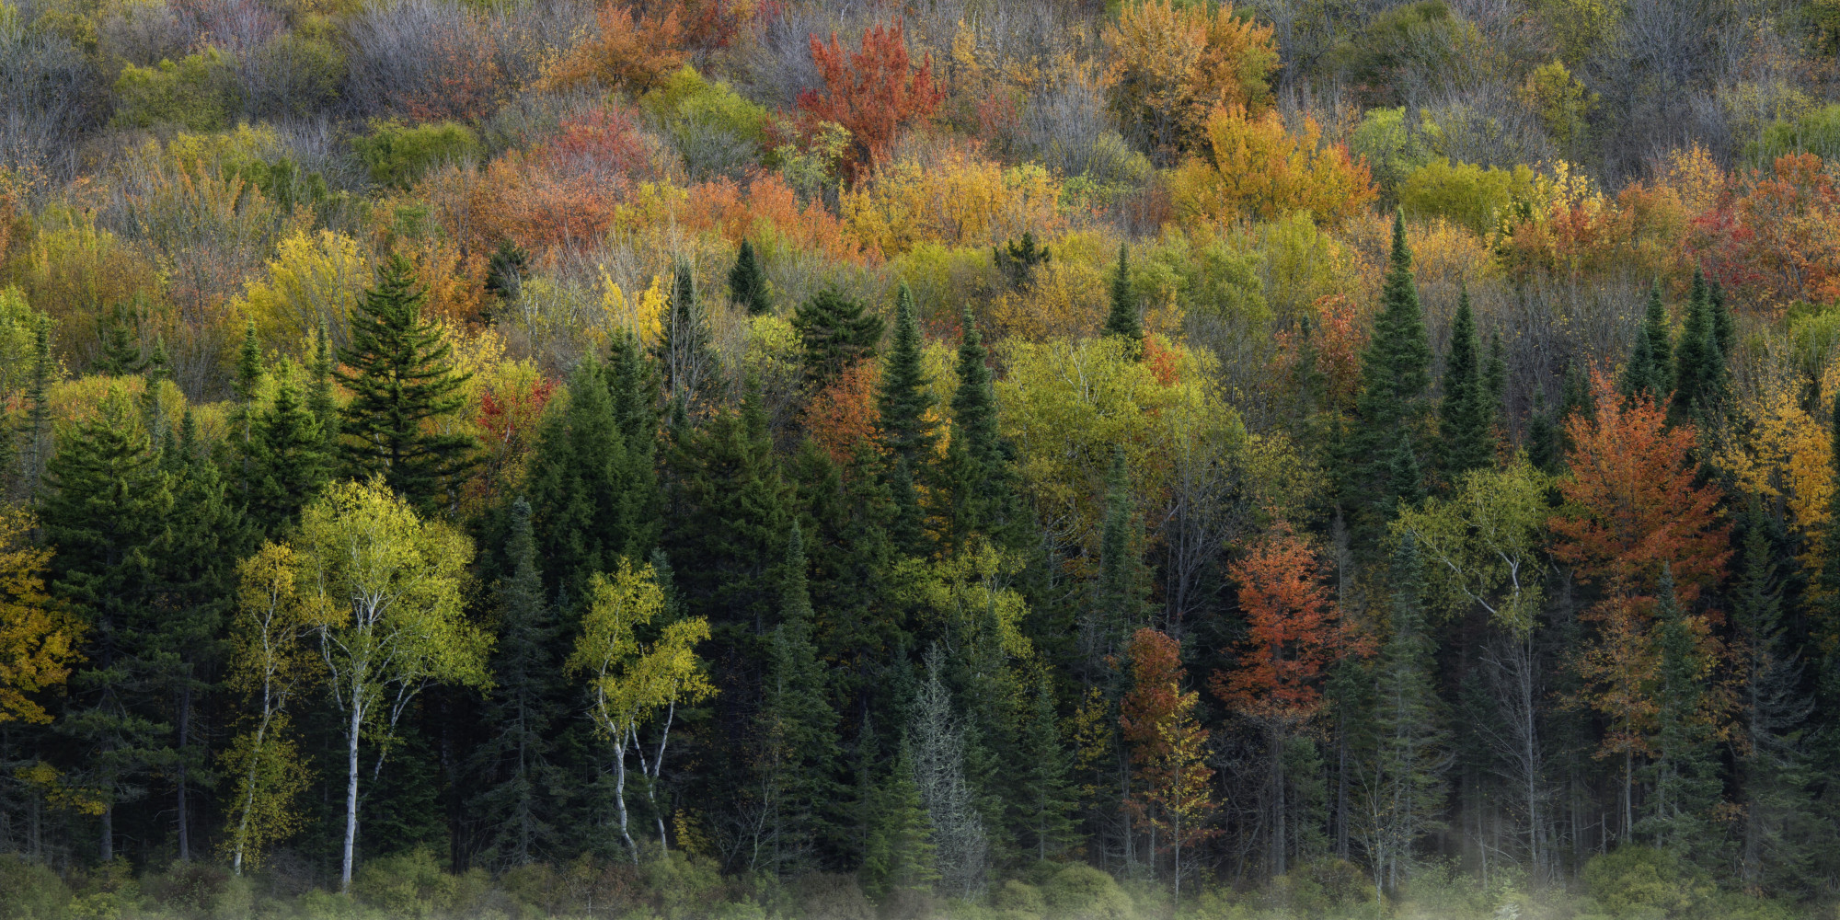
Top Priority Strategies
List top 5-7 priorities

Slide 17
Questions?

Slide 18
Thank You!!!!!

