Slide 1





Steering Committee Kickoff
DATE
Location

Slide 2

Introductions

Slide 3
What Will We Be Doing Today?

Slide 4
Agenda
Local Steering Committee Orientation & An Initial Visioning Session
Intro Presentation: project overview, process, timeline expectations deliverables
Individual SWOT Worksheet (Strengths, Weaknesses, Opportunities, and Threats)
Facilitated Discussion

Slide 5
Project Overview

Slide 6
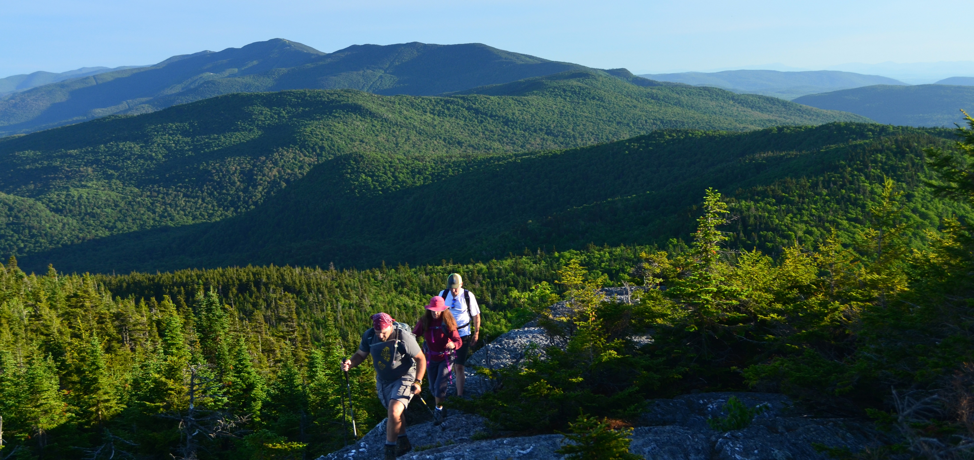
Background and Context
A Small State With a Big Reputation for Forest-Based Recreation
Long tradition of forest-based recreation
New outdoor recreation paradigm in Vermont
Resources, organizations and agencies beginning to coalesce around enhancing recreation
Notes:
Exemplified by:
FPR’s recent restructuring and refocusing on recreation
ACCD’s greater support and analysis of the interactions between recreation and community vibrancy
VCDA and others focusing on the economic impact of trails and dispersed recreation in our state
Congressman Welch’s work on the Outdoor Recreation’s Economic Contributions (REC) Act,
Governor Scott’s VOREC initiative
This Project!!!

Slide 7
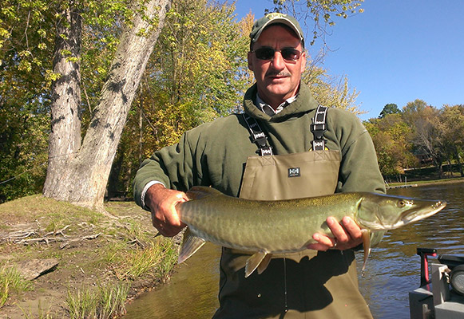
Project Purpose and Scope
Empowering Our Community to Move Forward with Confidence for the Town Forest
Four Key Areas:
Working from Town Forest Recreation Planning Toolkit that enables planning in ALL Vermont communities
Developing a compelling and inspiring vision to help guide the future management
Developing discrete, clear and action-oriented strategies for improvement of recreation and stewardship that achieves the vision
Fostering implementation with support for local plan adoption, guidance for implementation
Networking with your peers in nine other VT communities is just an added benefit!
Notes:
Town forests a such an important part of so many Vermont forests, and we are now starting to wise up to the full picture of how important recreation is in Vermont, it was reconized there was a lack of recreation and stewardship plans in many of vermonts town forests.
So the State and UCF went after this grant from the USFS to bring money to help develop 10 town forest plans in Ver
But when we saw that, we thought we don’t want to just do 10 separate plans and not learn anything through the process, so what we proposed and they have bought into is this idea of developing the town forest recreation planning toolkit as we go through this process which can be used by any Vermont community looking to do a vision and action plan for their town forest..
Which you see up there is the first of four key areas.
Now the toolkit development wont directly involve you guys that much—we are going to be doing all the toolkit materials and facilitating all the meetings with you guys which other Vermont towns wont get--but I want you to be aware of it and understand that aspect of the overall project that we are all working on
I will show some examples in a minute, but the toolkit is essentially all the materials needed to carry out the town forest planning processes we are going to complete with each of you by towns without consultant help.
We’ll be providing instructions, templates, process directions, best practices, tools like trail standards, assessment forms and user counting methods
More on that in just a minute. For now, lets look at the other 3 key areas of the project, which you we will be guiding you through.
Developing a compelling and inspiring vision to help guide the future management of each of the ten selected town forests
Developing discrete, clear and action-oriented strategies for improvement of recreation and stewardship that achieves the vision
Fostering implementation with support for local plan adoption, guidance for implementation, and the Implementation Summit

Slide 8
Recreation Planning Toolkit
Everything We Need to Complete a Town Forest Recreation Plan
Existing Conditions & Assessment Pod
Public Engagement Pod
Natural Resources Pod
Plan Development Pod
Implementation Pod
Town Forest Stories Pod

Slide 9
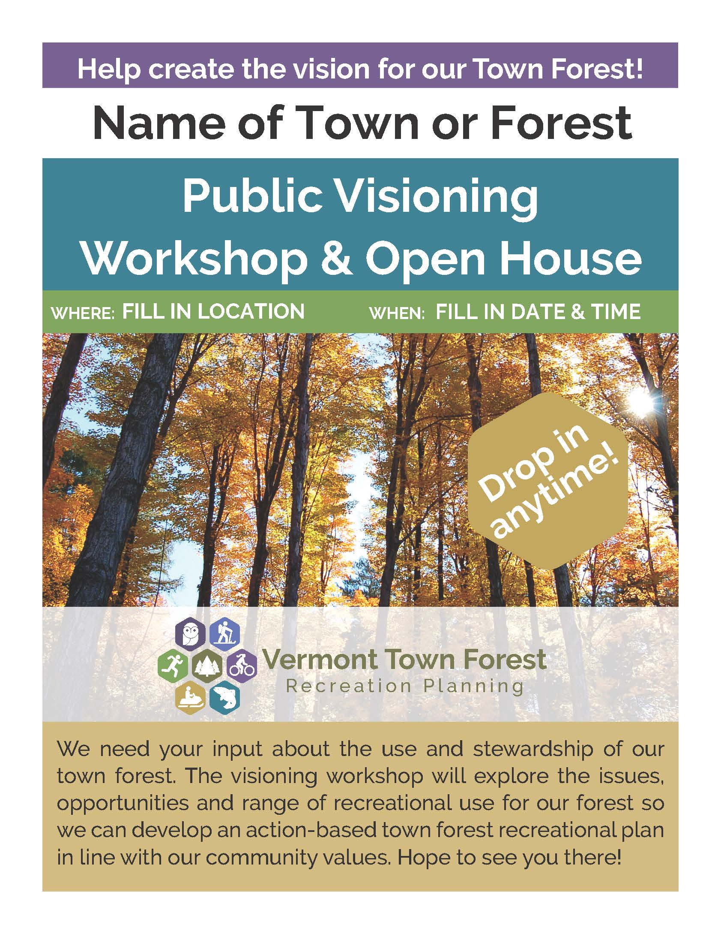

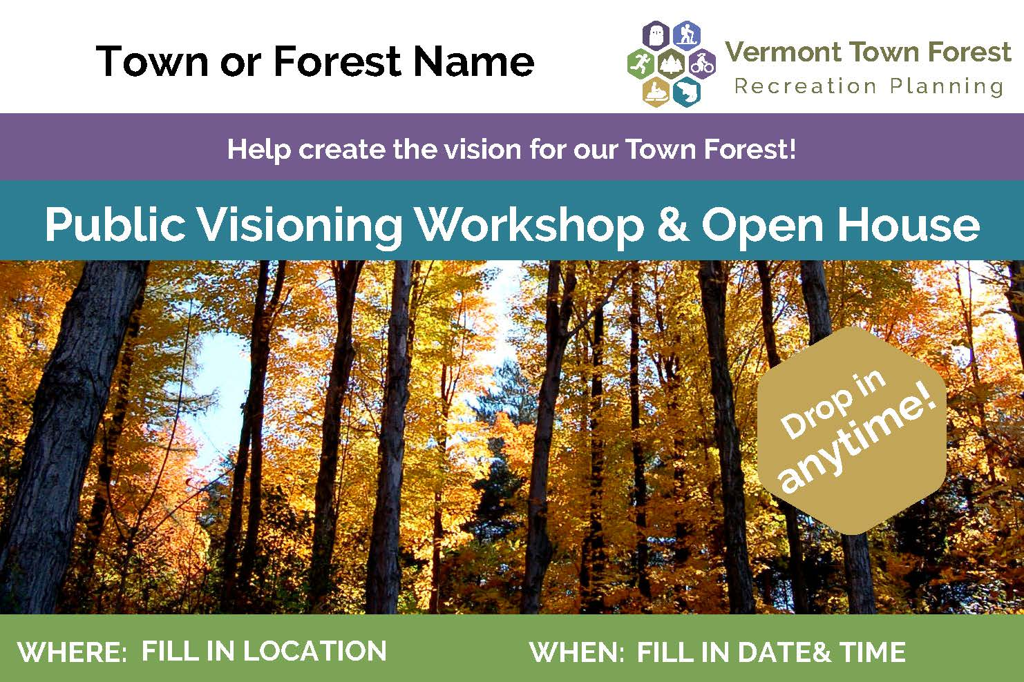
Toolkit Example
“Fillable-Form” PDFs for EVERYTHING in the Process

Slide 10
Project Timeline
ADD YOUR OWN

Slide 11
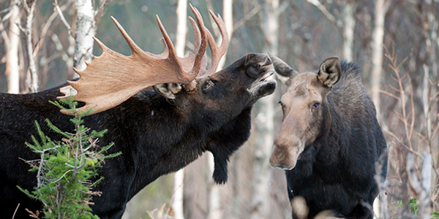
Project Process
How Will We Get There From Here?
  Compile Base Information and Needs Assessment Data
      Currently Underway
  Town Forest Recreation Planning Steering Committee Kickoff
      Today!
  Public Visioning Workshop and Survey
      DATE
  Vision Framework Development
      DATE (period)
  Strategies Workshop
      DATE
  Plan Development
      DATE
  Plan Presentation and Review
      DATE
  Final Plan
      DATE

Slide 12
Project Deliverables

Slide 13
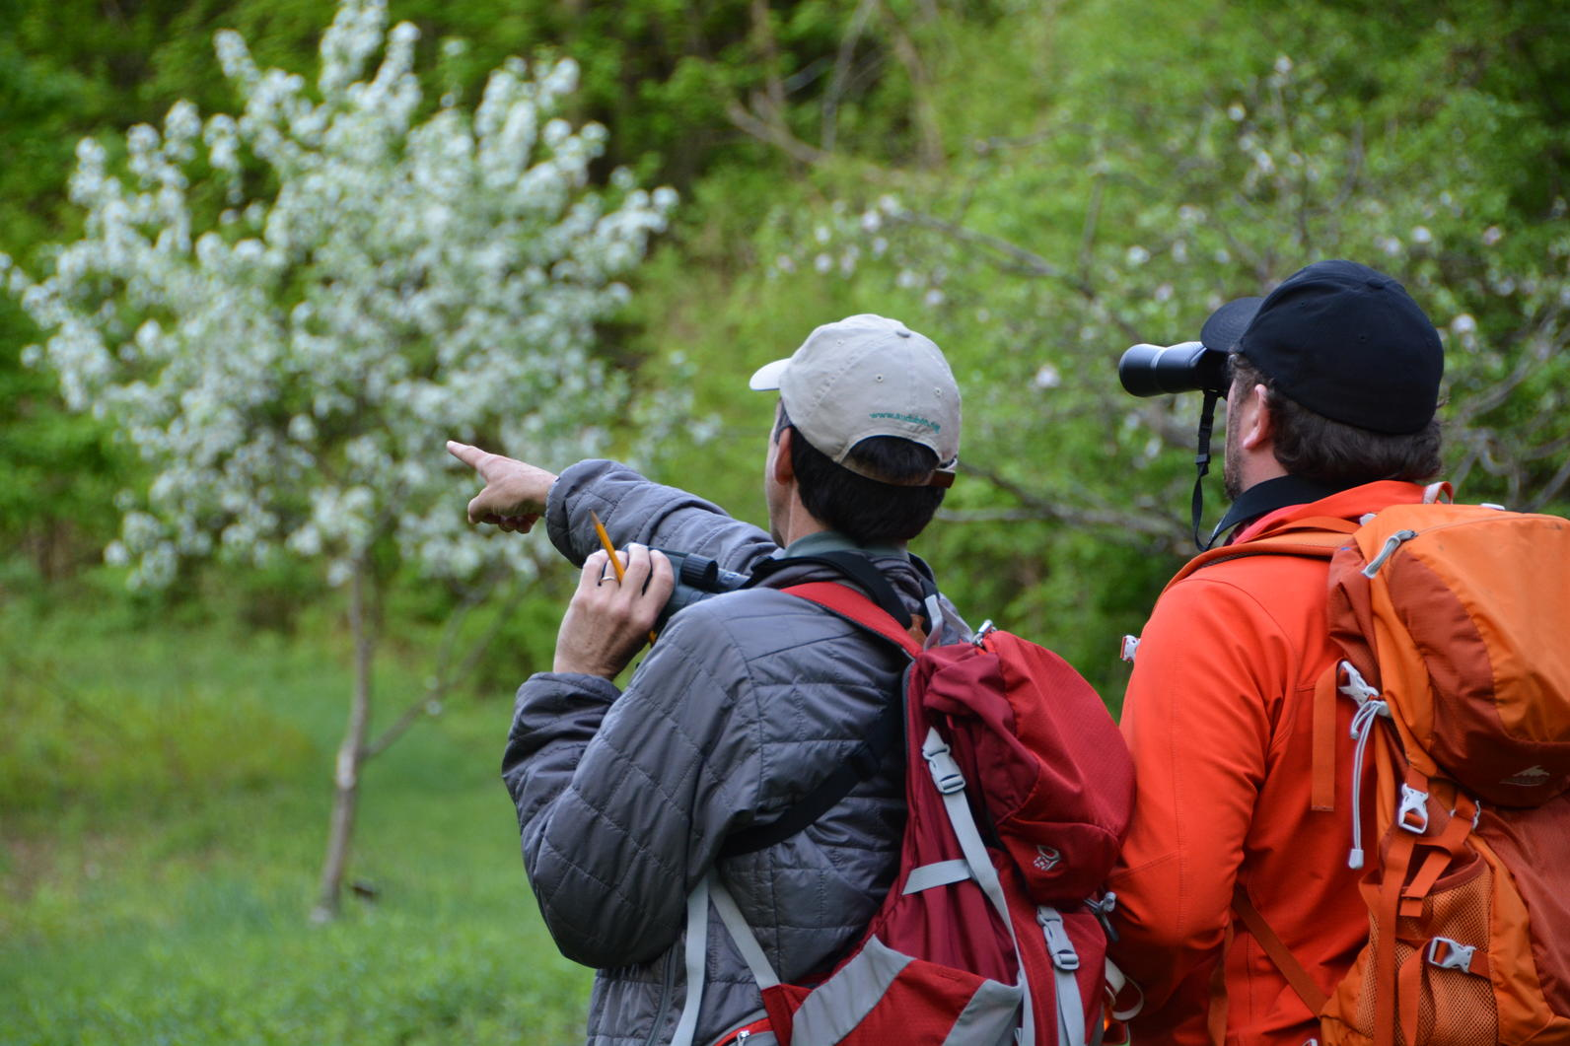
Project Deliverables
A Robust Town Forest Recreation Plan Document
4 Chapters:
  Introduction and Community Profile
  Public Engagement Summary & and Needs Assessment
  Town Forest Vision Framework
  Town Forest Action Plan

Slide 14
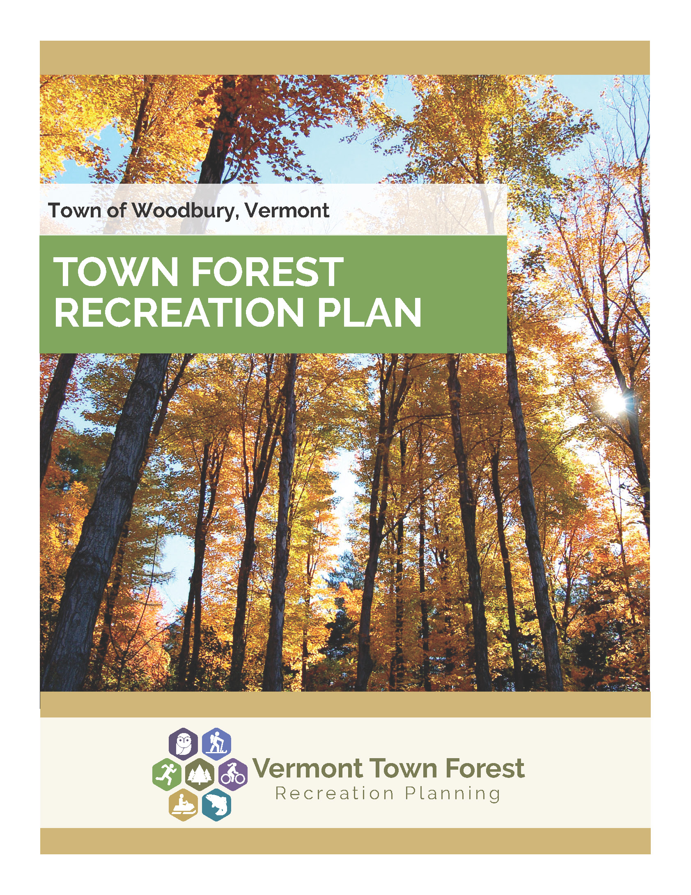
Project Deliverables
A Vision Framework Document to Guide the Future Direction of Your Town Forest
Community Vision Statement for the Town Forest
Goals for Key Focus Areas
Discussion of Potential Recreational Uses Identified By Community

Slide 15
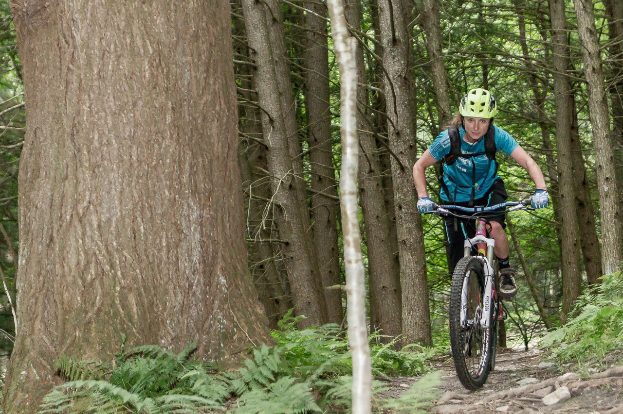
Project Deliverables
Action Plans With Discrete, Clear and Implementable Strategies for Improvement of Recreation
Action Plans will identify:
  Project description
  Action responsibility
  Timing (immediate, short, medium, long-term)
  Partners involved
  Action or planning dependencies
  Available support resources
  Funding and grant opportunities
  Magnitude of costs
  ($-$$-$$$-$$$$)
Photo Courtesy of John Atkinson, Mad River Riders
Everything you need to go after grants to implement these projects!

Slide 16
Project Deliverables
Action Plans With Discrete, Clear and Implementable Strategies for Improvement of Recreation

Slide 17
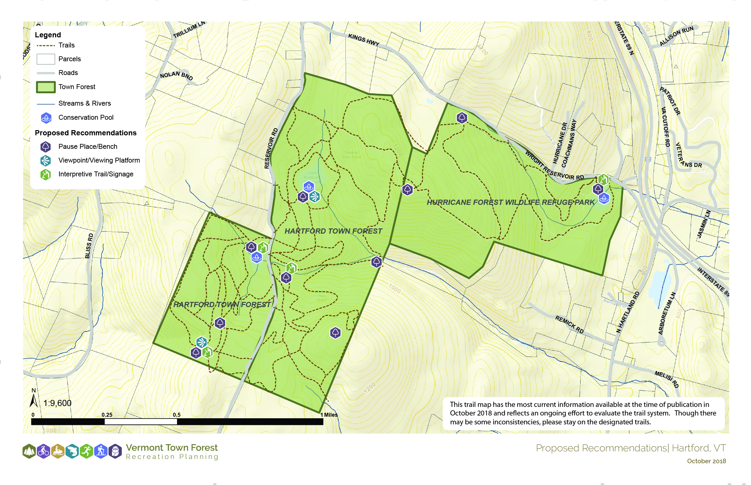
Project Deliverables
Bubble Diagram Maps—Planning Before Design

Slide 18
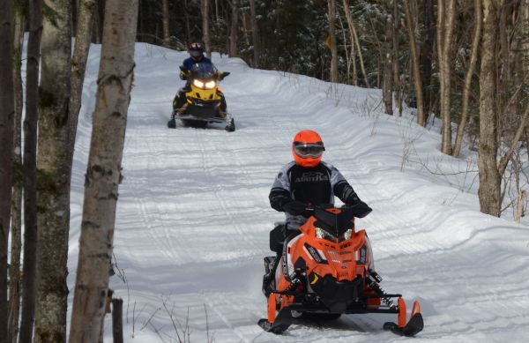
Project Outcomes
Public Engagement and Buy-In for Your Town Forest Plan
“Thank you for seeking public input in such an organized fashion. You’ve done an excellent job of providing an easy, non-time-consuming way for citizens to review the plans and offer comments. ”
Notes:
The biggest value we’ve seen in any of these processes is always the momentum, energy, and excitement that is generated by bringing the community together to discuss these issues

Slide 19
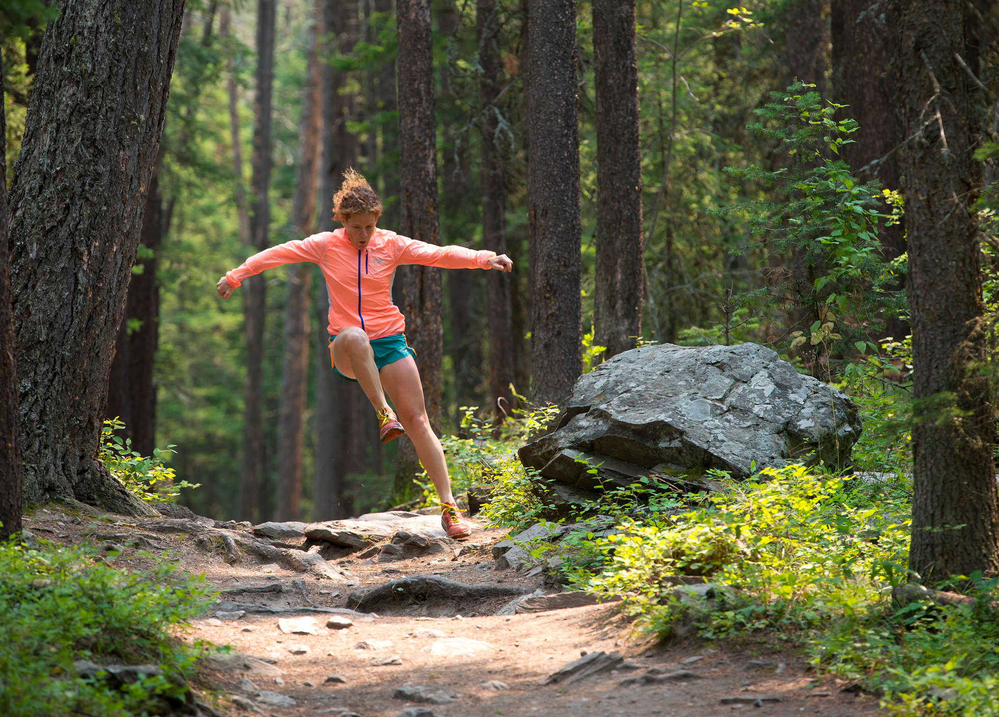
Project Outcomes
A Thoughtful Plan for Recreation in Your Town Forest
Comprehensive consideration of projects so you can move forward with confidence
  You have heard the community
  You are protecting the forest resource
  You are effectively managing the forest for the resources you value

Slide 20
Steering Committee Role and Responsibilities

Slide 21
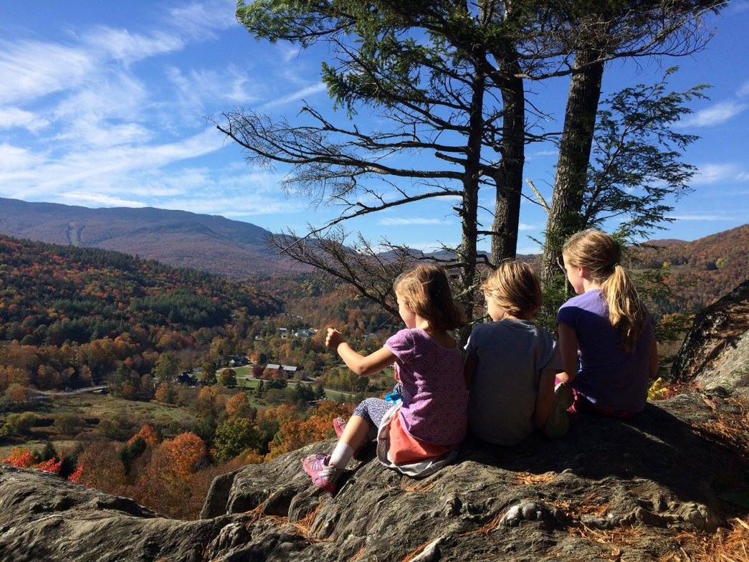
What Do We Need From You?
What Will Steering Committee Members Be Doing?
Energy, excitement, passion and ideas!!!!
Attendance at steering committee meetings and public workshops
Scheduling, promoting, and reserving space for meetings and workshops
Some Homework
  TBD – analyzing public input, drafting the plan, etc.
Plan Ambassador Role
Attendance at other community events to promote the planning process
Carrying projects through implementation
Notes:
Plan Ambassador Role
Attendance at other community events to promote community visioning (town meeting day, farmers markets, harvest festivals, etc.)
Meeting with your committee outside of the meetings with the consultant team to review documents and generate ideas
Carrying projects through implementation

Slide 22
Questions?

Slide 23
Thank You!!!!!

