Slide 1





Town Forest Draft Strategies Workshop
DATE
FOREST NAME
Notes:
Are these the right logos?

Slide 2

Agenda

Slide 3
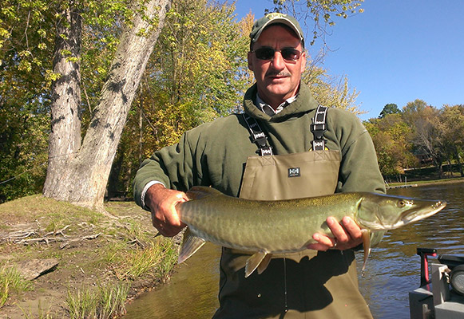
Agenda
What are we going to do tonight?
Presentation (7:00-8:00 PM)
  Project Overview and Progress
  Draft Vision Framework
  Draft Strategies
  Large Group Questions/Discussion
Open House Workshop (8:00-8:30 PM)
  Priority Boards
  Write-In Map
  Facilitator Conversations
  Comment Box
  No closing presentation—leave when you’re done!
Notes:
Town forests a such an important part of so many Vermont forests, and we are now starting to wise up to the full picture of how important recreation is in Vermont, it was reconized there was a lack of recreation and stewardship plans in many of vermonts town forests.
So the State and UCF went after this grant from the USFS to bring money to help develop 10 town forest plans in Ver
But when we saw that, we thought we don’t want to just do 10 separate plans and not learn anything through the process, so what we proposed and they have bought into is this idea of developing the town forest recreation planning toolkit as we go through this process which can be used by any Vermont community looking to do a vision and action plan for their town forest..
Which you see up there is the first of four key areas.
Now the toolkit development wont directly involve you guys that much—we are going to be doing all the toolkit materials and facilitating all the meetings with you guys which other Vermont towns wont get--but I want you to be aware of it and understand that aspect of the overall project that we are all working on
I will show some examples in a minute, but the toolkit is essentially all the materials needed to carry out the town forest planning processes we are going to complete with each of you by towns without consultant help.
We’ll be providing instructions, templates, process directions, best practices, tools like trail standards, assessment forms and user counting methods
More on that in just a minute. For now, lets look at the other 3 key areas of the project, which you we will be guiding you through.
Developing a compelling and inspiring vision to help guide the future management of each of the ten selected town forests
Developing discrete, clear and action-oriented strategies for improvement of recreation and stewardship that achieves the vision
Fostering implementation with support for local plan adoption, guidance for implementation, and the Implementation Summit

Slide 4
Project Overview

Slide 5
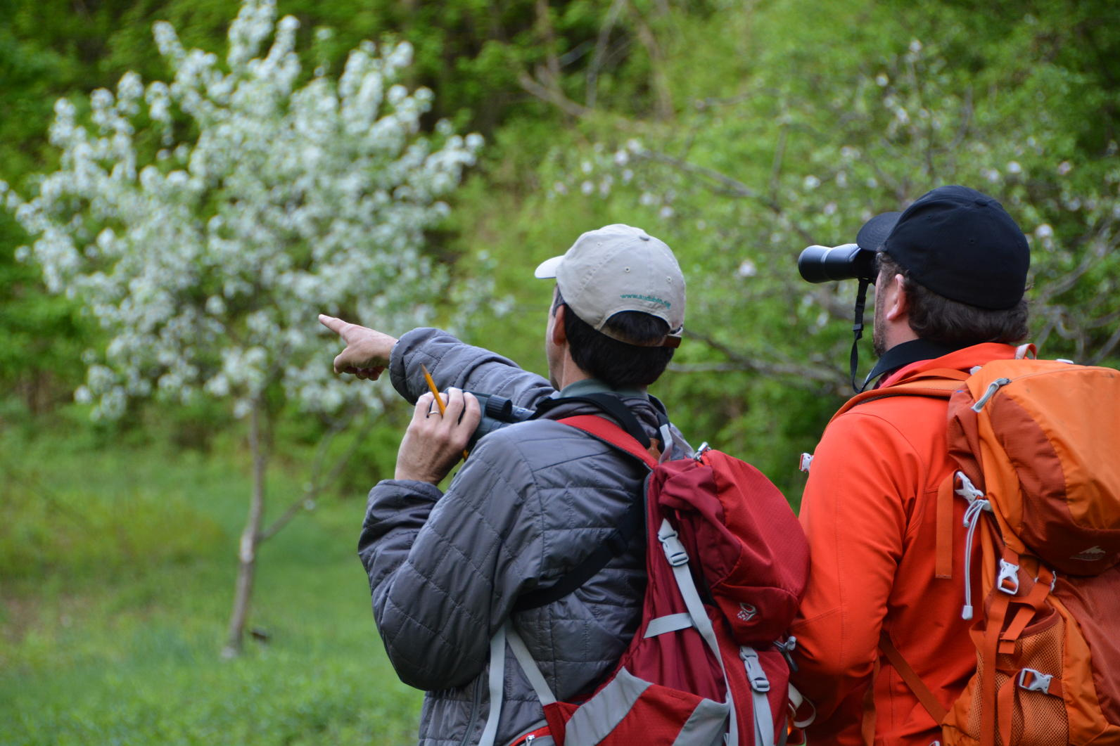
Project Purpose and Scope
Empowering Communities to Move Forward with Confidence in their Town Forest
Three Key Areas:
Developing a compelling and inspiring vision to help guide the future management of each of the ten selected town forests
Developing discrete, clear and action-oriented strategies for improvement of recreation and stewardship that achieves the vision
Fostering implementation with guidance, best practices and tools for implementation in the project toolkit
Notes:
Town forests a such an important part of so many Vermont forests, and we are now starting to wise up to the full picture of how important recreation is in Vermont, it was reconized there was a lack of recreation and stewardship plans in many of vermonts town forests.
So the State and UCF went after this grant from the USFS to bring money to help develop 10 town forest plans in Ver
But when we saw that, we thought we don’t want to just do 10 separate plans and not learn anything through the process, so what we proposed and they have bought into is this idea of developing the town forest recreation planning toolkit as we go through this process which can be used by any Vermont community looking to do a vision and action plan for their town forest..
Which you see up there is the first of four key areas.
Now the toolkit development wont directly involve you guys that much—we are going to be doing all the toolkit materials and facilitating all the meetings with you guys which other Vermont towns wont get--but I want you to be aware of it and understand that aspect of the overall project that we are all working on
I will show some examples in a minute, but the toolkit is essentially all the materials needed to carry out the town forest planning processes we are going to complete with each of you by towns without consultant help.
We’ll be providing instructions, templates, process directions, best practices, tools like trail standards, assessment forms and user counting methods
More on that in just a minute. For now, lets look at the other 3 key areas of the project, which you we will be guiding you through.
Developing a compelling and inspiring vision to help guide the future management of each of the ten selected town forests
Developing discrete, clear and action-oriented strategies for improvement of recreation and stewardship that achieves the vision
Fostering implementation with support for local plan adoption, guidance for implementation, and the Implementation Summit

Slide 6
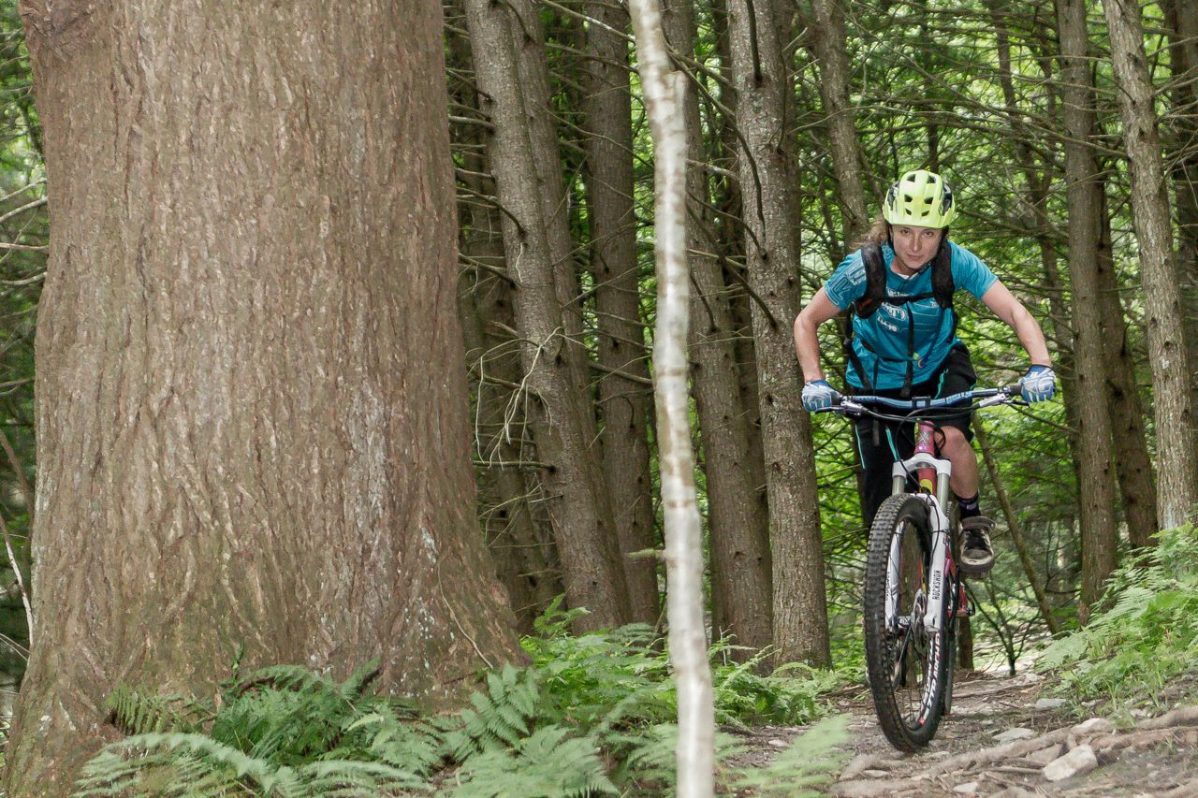
Project Deliverables
Action Plans With Discrete, Clear and Implementable Strategies for Improvement of Recreation
Action Plans will identify:
  Project description
  Action responsibility
  Timing (immediate, short, medium, long-term)
  Partners involved
  Action or planning dependencies
  Available support resources
  Toolkit resources
  Funding and grant opportunities
  Magnitude of costs
  ($-$$-$$$-$$$$)
Photo Courtesy of John Atkinson, Mad River Riders
Everything you need to go after grants to implement these projects!
Notes:
Same as january

Slide 7
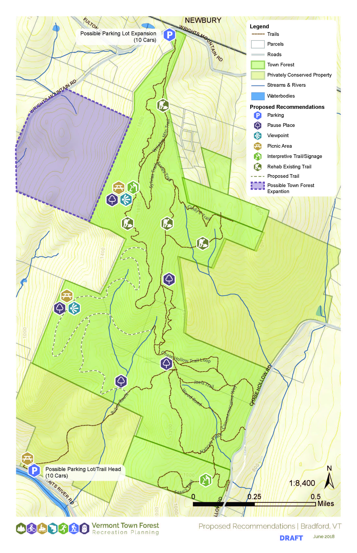
Project Deliverables
Bubble Diagram Maps—Planning Before Design
Notes:
From January

Slide 8
Our Recreation Planning Toolkit
Additional resources and information to complete and implement your plan
Some of the resources we have access to:
Management Zones Toolkit
Promotional material and public meeting templates
Guidance and best practices on meeting promotion and facilitation
Community survey questions
Survey interpretation and vision crafting guidance
Resource protection guidance
Case studies of each of the 10 towns and your plans
Personal narratives from the 10 towns
Recreational improvements strategy database
Index of standard recreational improvement costs
How-to webinars
Grant Writing Best Practices
Sustainable Trail Standards
Pause Places Toolkit
Volunteer Project Designs
Parking
Considerations
Toolkit
Trail Counting Forms
Model Process for New Trails
Vtrans Signage Program
Conservation Best Practices

Slide 9
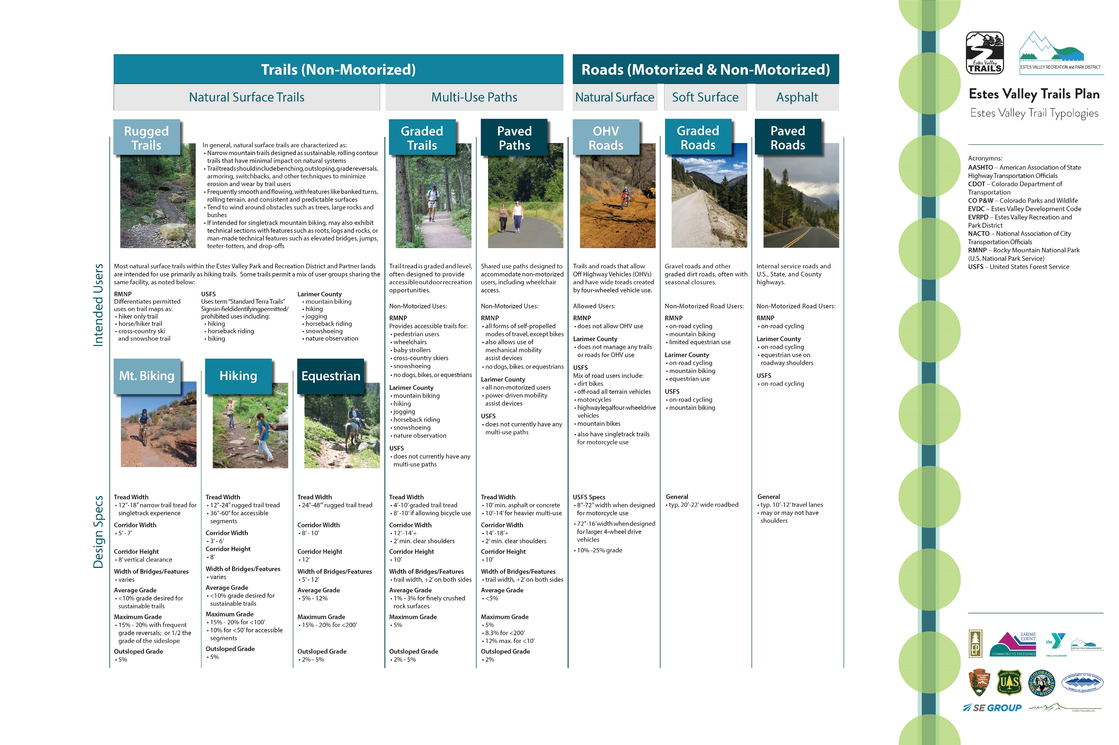
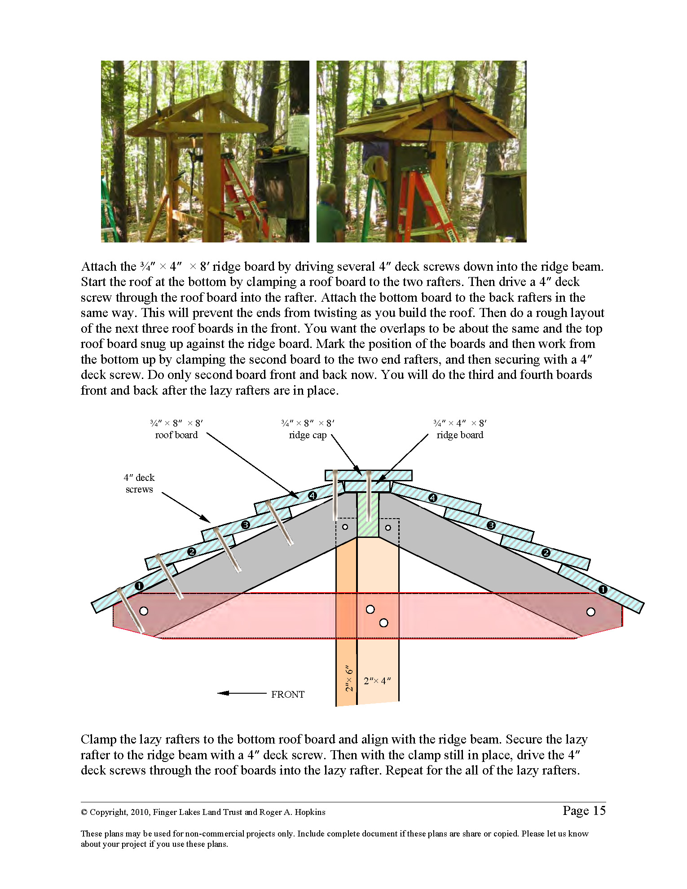
Project Deliverables
An Implementation Toolkit with Best Practices for Design
Notes:
From January

Slide 10
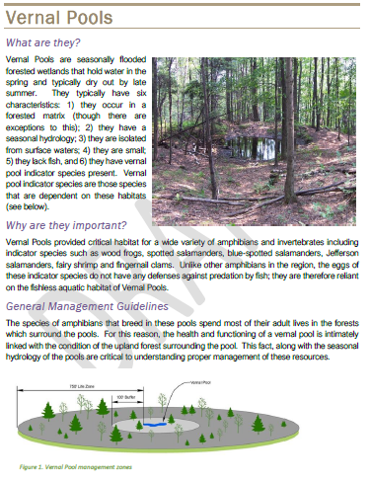
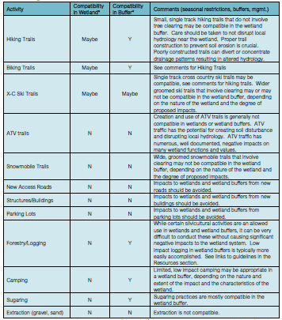
Natural Resources Guidelines
Section about each natural community in the forest: vernal pools, floodplain forests, wetlands, deer wintering areas, etc.
For each, there’s background information, explanation of its importance, general management guidelines, regulatory issues, links to additional resources and guidelines, and a matrix of compatible activities.

Slide 11
Phase 1: Visioning
Phase 2: Strategies Development
Phase 3: Plan Development
Phase 4: Implementation
Public Visioning Workshop
Community Survey
Steering Committee Visioning
Draft Vision Framework for Town Forest
Environmental Considerations & Site Constraints
Develop Range of Strategies to Achieve Vision
Legend
Strategies Workshop:
Review Draft Vision
Select & Prioritize Strategies
You Are Here
Community Input
Project Toolkit & Document Templates
Draft Action Plan
Plan Presentation Workshop
Final Plan Document
Construction & Design Standards
Management Best Practices
Implementation Coaching
Funding & Support Resources

Slide 12
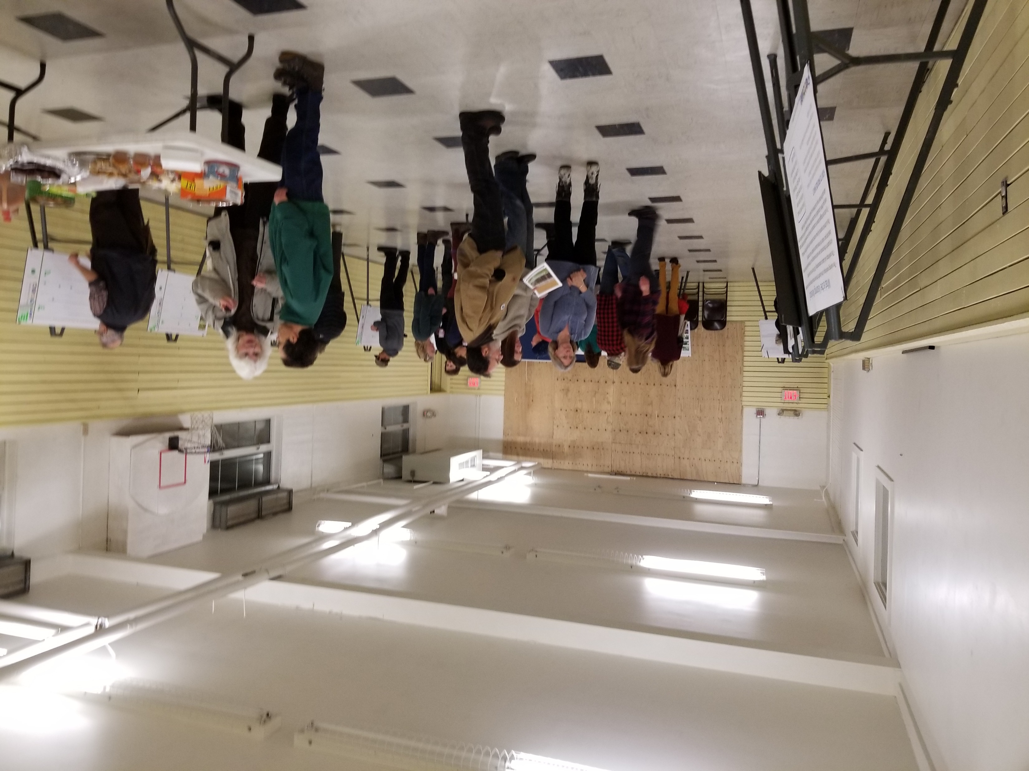
Project Progress
Community Visioning & Draft Strategies
Forest Walk
  Identifying areas of ecological and recreational importance in the forest
Steering Committee Meetings
  Analysis of Strengths, Weaknesses, Opportunities, and Threats to the forest
Public Workshop
  DATE
  ___ attendees
  Questions about a vision, natural resources, activities, programs, and events in the forest
Survey
  ___ responses
  Available both online and hard copy
  Same questions as the public workshop
Photo of Public Workshop
This information was taken into account in developing natural resource guidelines, vision framework, and strategies for the forest
Notes:
This is the extent of the info for the public workshop and survey? Is that ok? No word clouds?

Slide 13
Vision Framework

Slide 14
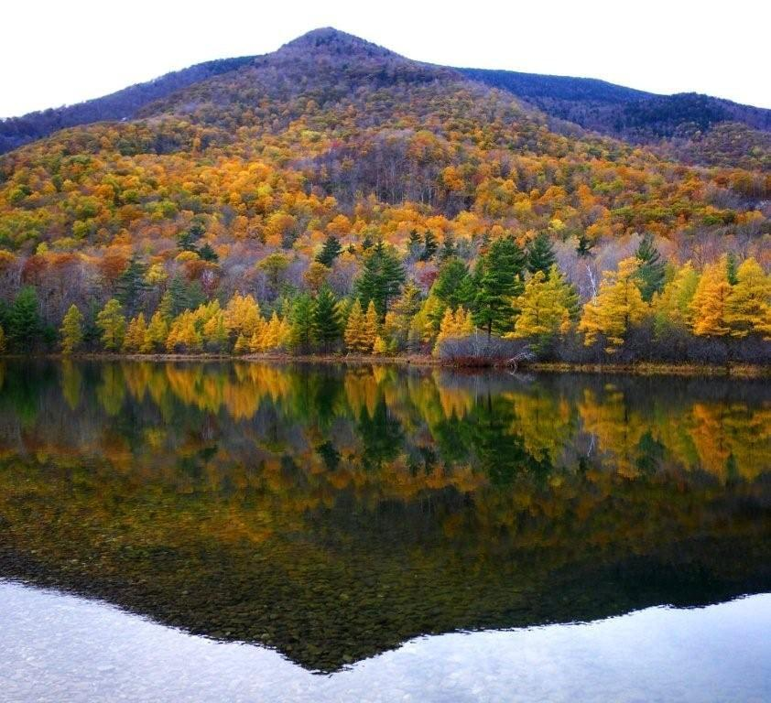
Vision Framework
Turning the community’s ideas into a framework for the future
Community’s ideal conditions for the forest
Encompasses a variety of local perspectives
Allows for more complexity than a 1-2 sentence vision statement
Includes:
  A discussion of management balance in the forest
  A list of key attributes that describe the community’s desired character for the forest
This framework covers all forest uses (not just recreation)

Slide 15
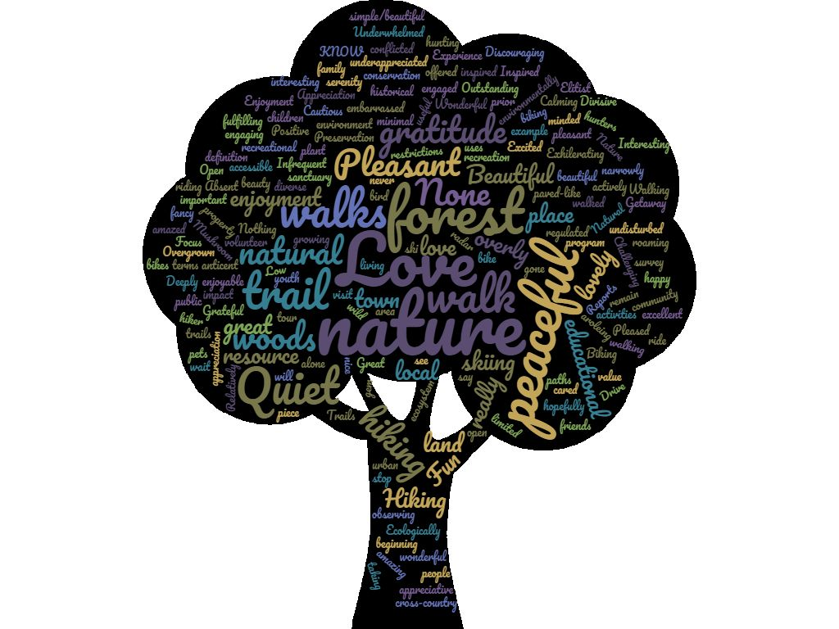
Existing Experiences
What word or phrase best describes your EXISTING experience with our town forest?
Wordcloud from survey results

Slide 16
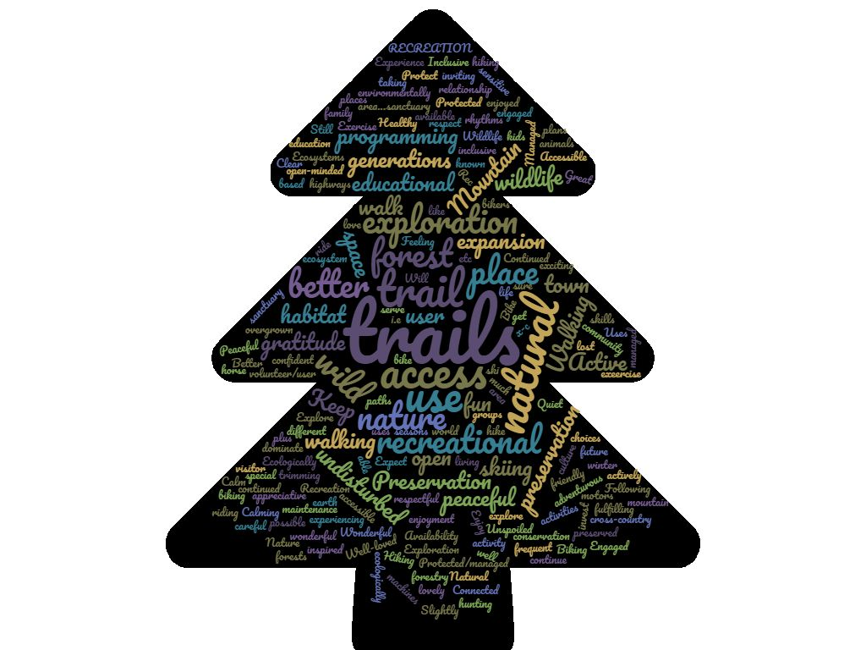
Future Experiences
What word or phrase best describes your DESIRED FUTURE experience with our town forest?
Wordcloud from survey results

Slide 17
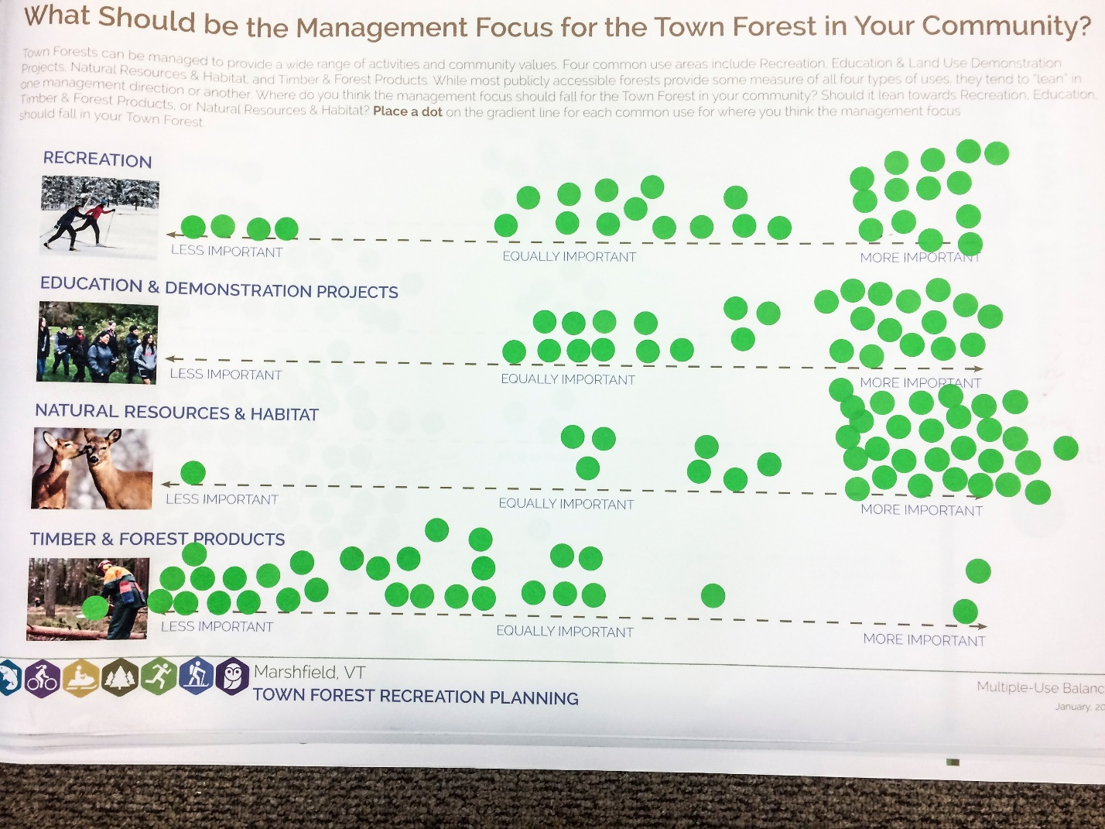
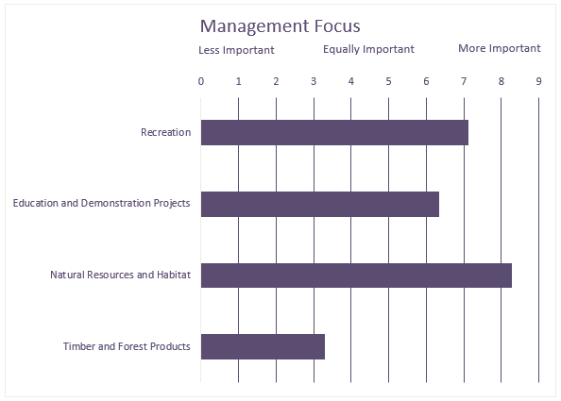
Management Balance
Where should the management focus fall for the Town Forest in your community?
The Marshfield community expressed that Natural Resources & Habitat, Education & Demonstration Projects, and Recreation are more important uses in the management of the forest than Timber & Forest Products. Both survey respondents and workshop participants felt that Natural Resources & Habitat were most important.
Management focus summary written for vision framework
Public Workshop results
Online Survey results
Workshop Participants
Survey Respondents

Slide 18
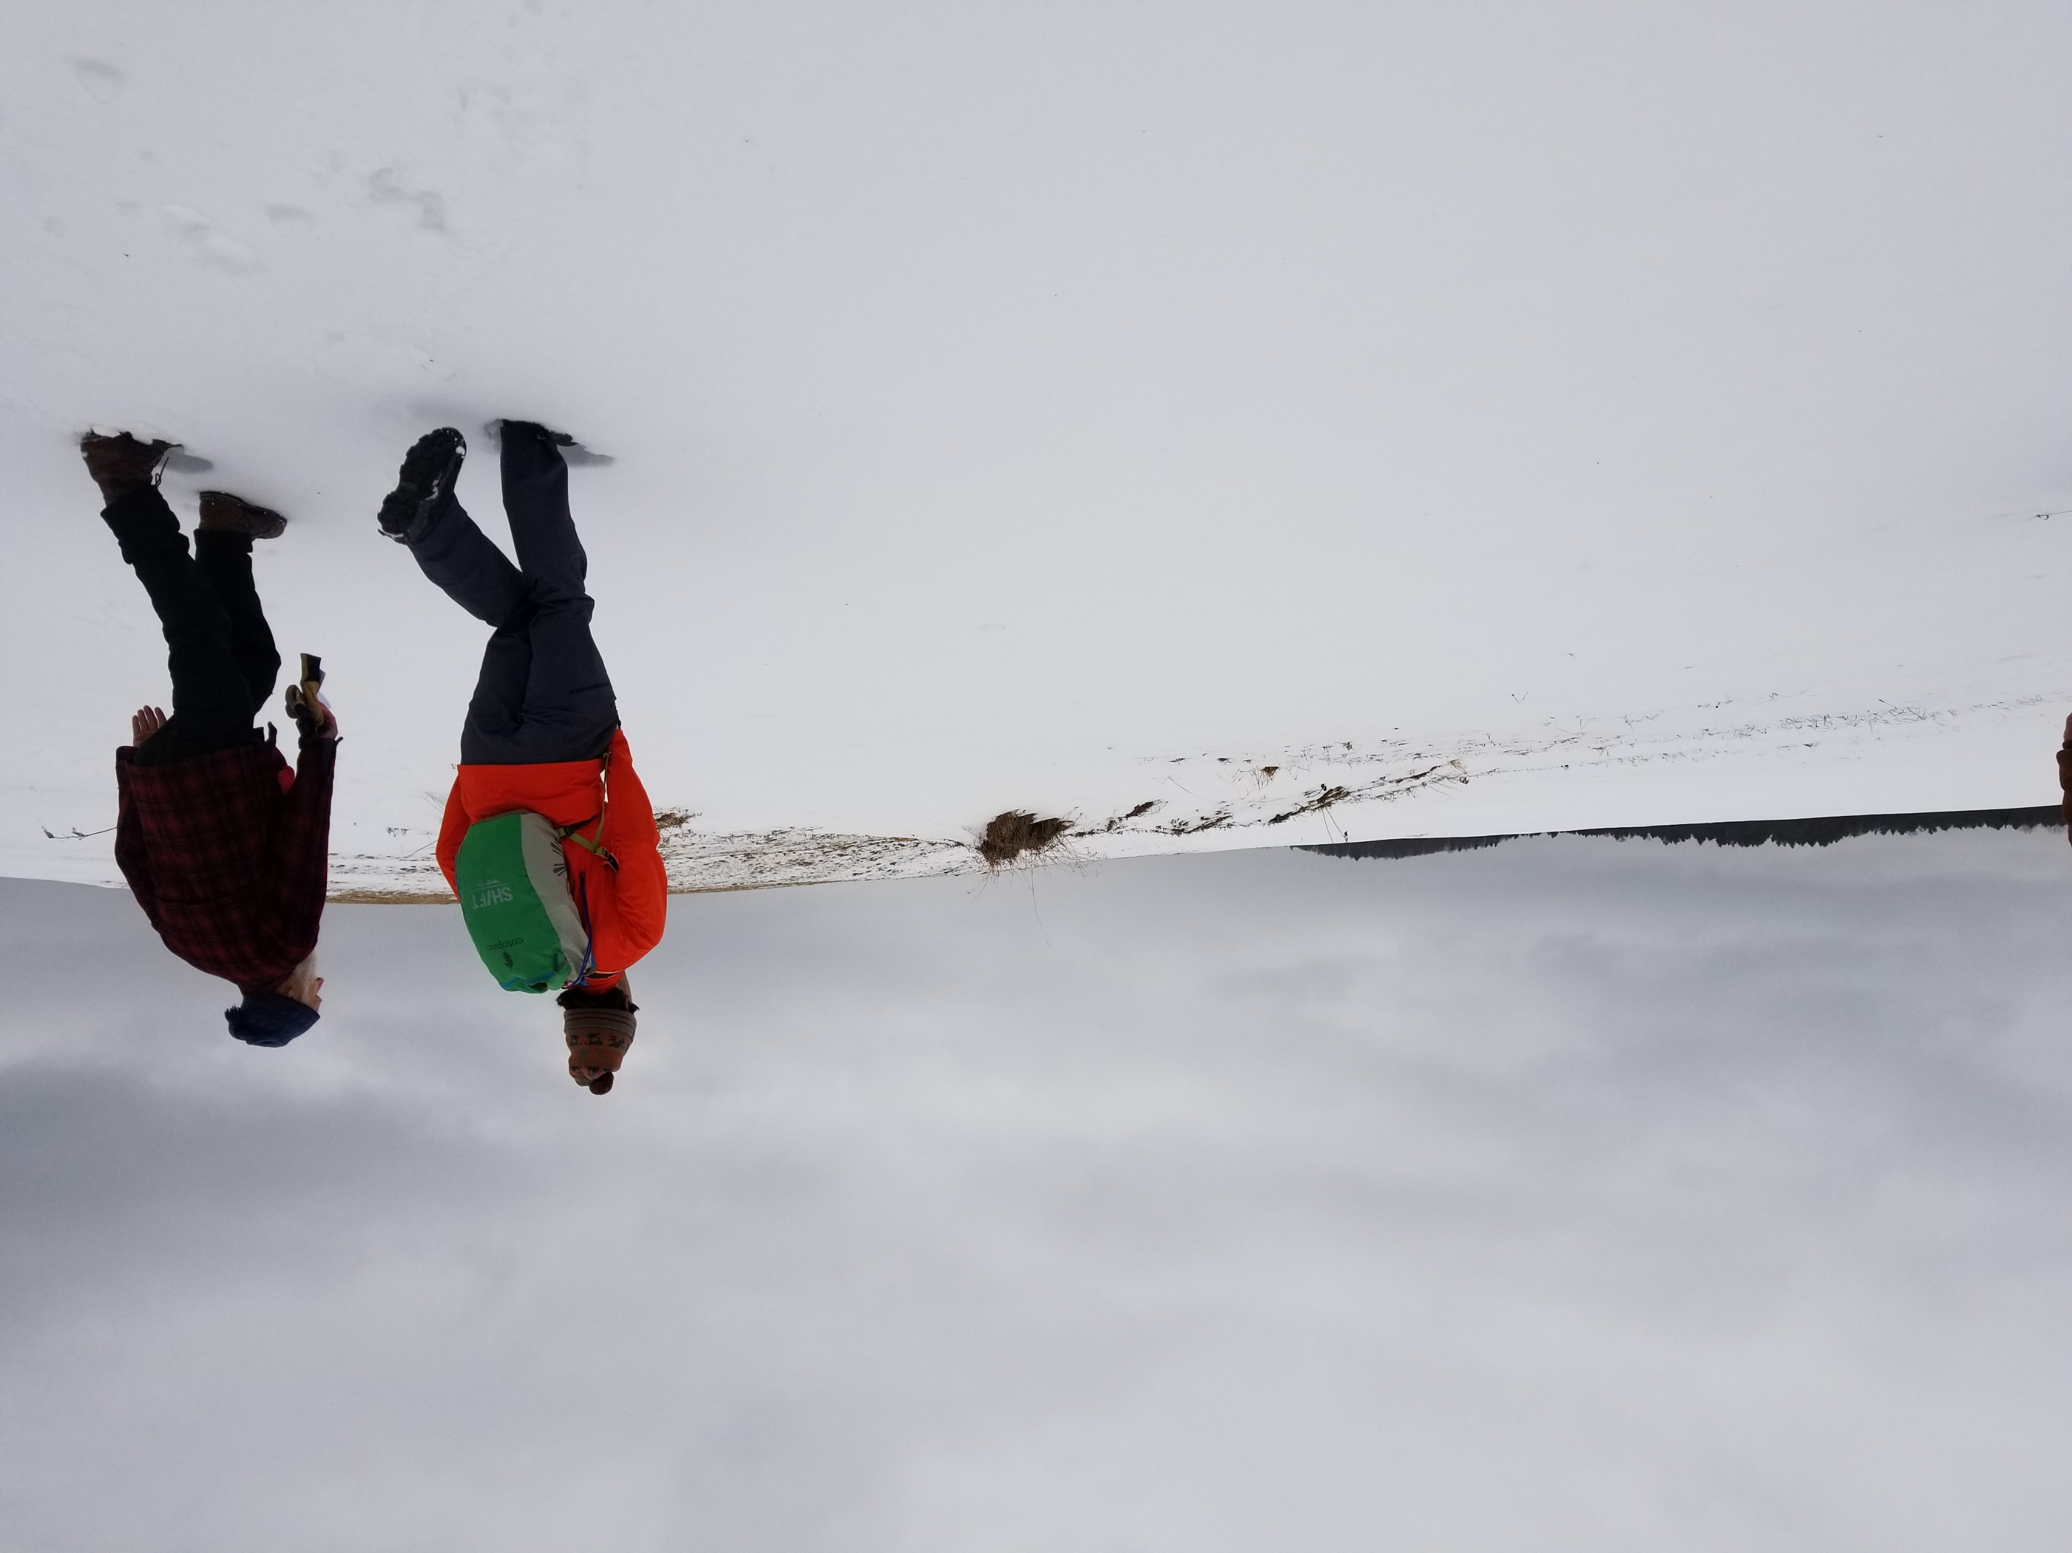
Key Attributes
Words or short phrases that communicate what the community believes are the ideal conditions for the forest - the same or different from how things looks today
Multi-dimensional (haying, sugaring, habitat, conservation, recreation, etc.)
Peaceful and quiet
Sustainable and well-maintained trail system
Protection of wildlife habitat
Protection of vernal pools, wetlands, and other water resources
Inclusive of a variety of users and community perspectives
Year-round recreation (snowshoeing, biking, hiking, cross country skiing)
A piece of a larger conserved forest block
Connectivity to other forested areas
Maintain healthy balance between stewardship and human uses
Low key and low intensity use
Place to appreciate the natural world
Multi-generational
Preserve and interpret cultural and historical resources
Solitude, rest, and rejuvenation
Opportunities for learning about stewardship, history and the forest
Community utilized and maintained
Well managed with the Forest Committee, Select Board, and input from the community
Beautiful views
Engaged and appreciated volunteer group
Well-located and accessible
Remarkable biodiversity
Key attributes from Vision Framework

Slide 19
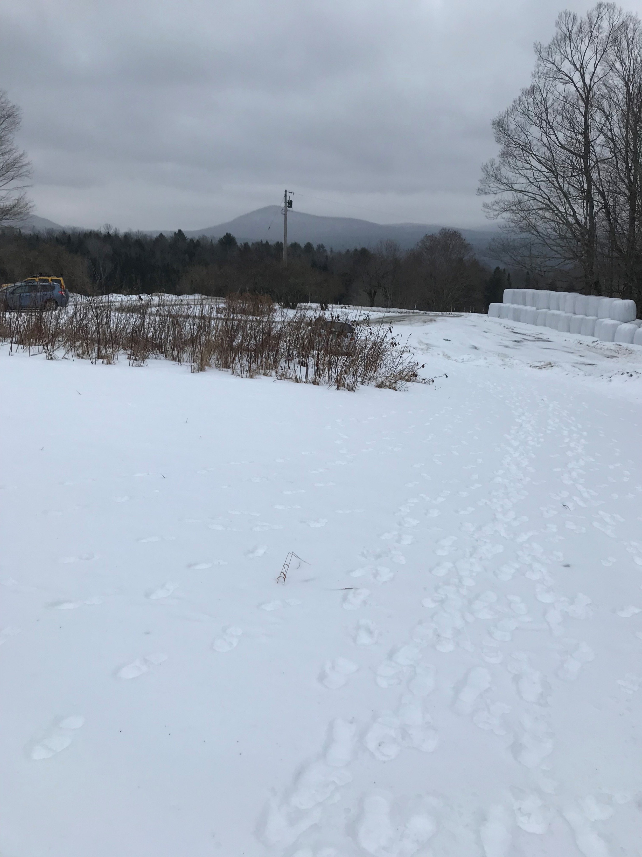
Issues, Needs, and Ideas
Identifying the current condition of the forest and opportunities for improving and achieving the key attributes
Timber management impacts
Some trails, particularly old logging roads, have poor drainage
Balancing uses
Potential for overuse
Potential conflicts with private landowners
Confusion around forest vs. private land boundary
Drainage and condition of Thompson Road
Lack of data on forest use
Limited accessibility for elders and persons with disabilities
Sap lines through the forest
In need of additional funding sources
Need for collaborative community dialogue around forest use
Issues, needs, and ideas identified in Vision Framework

Slide 20
Strategies

Slide 21
Trails Strategies
Strategy or Action | Description | Relative Cost ($-$$-$$$-$$$$) | Toolkit & Support Resources
2. Trails
Existing trail conditions assessment and review | Continue to study existing trails, especially those following former logging roads, and evaluate for potential ecological harm and mitigate the site through necessary means. Decommission or reroute trails as needed. | $ | -Trail assessment forms -Natural Resource Guidance Toolkit -Sustainable Trail Standards
New trail connections | Improve the existing trail system with strategic connections to enhance experiences for all user groups. Ensure system includes a mix of traditional footpaths and "bike-optimized" multi-use natural surface trails to provide desired experiences. Consider rebuild or replacement of existing logging roads or unsustainable trails to improve drainage, limit erosion, and limit trail density. New connections could include an apple picking trail (that leads to the orchard) or connections for an interpretive/history trail. | $$ | -Sustainable Trail Standards
New accessible path or interpretive trail | Build a graded, accessible path for all ages and abilities to enjoy the forest. Such paths are typically short (~1 mile) and provide ample opportunities for rest and education with stations or stops next to points of natural or cultural interest. Coordinate with educational programming. | $$$ | -Sustainable Trail Standards -Interpretation Guidance Toolkit
Trail markers and signage | Continue to add signage in the forest for wayfinding, information, and trail etiquette. Ensure it communicates town ownership and/or conservation commission management. | $$ | -Trail Markers and Wayfinding Toolkit -Interpretation Guidance Toolkit
Marshfield Trails Collaborative | Continue to convene mountain bikers, hikers, and other user groups for an on-going dialogue around trails and to establish a framework for collaboration in the future. | $ | -Volunteer Development and Recruitment Toolkit
Selected strategies from Vision Framework
Notes:
Will have as many of these slides as necessary

Slide 22
Other Facilities and Structures Strategies
Strategy or Action | Description | Relative Cost ($-$$-$$$-$$$$) | Toolkit & Support Resources
3. Other Facilities and Structures
Pause Places | Develop a series of "Pause Places" or "mini-destinations' along the trail system. These may be a rest stop, an informational stop, or both. All pause places should include a bench or appropriate rocks/boulders for seating and should capitalize on locations with the potential for views, sunsets, wildlife observation, rest, and rejuvenation. Opportunities for natural and historical interpretation should also be explored. | $$ | - Pause Places Toolkit -Bench Volunteer Designs '-Interpretation Guidance Toolkit
Restore Apple Orchard | Restore trail to apple orchard to open up access. Improve the orchard itself to become a community resource. | $$ | -Sustainable Trail Standards
Develop an outdoor classroom | Create a small gathering space with picnic tables, benches, earthen mounds etc. for schools and other groups. | $$ | - Sustainable Facility Standards -Natural Resource Guidance Toolkit
Notes:
Will have as many of these slides as necessary

Slide 23
Education & Programs Strategies
Strategy or Action | Description | Relative Cost ($-$$-$$$-$$$$) | Toolkit & Support Resources
4. Education & Programs
Educational Programs/Outdoor Program | Continue holding educational programs in the forest about the history and ecology of the forest. | $ | -Programming Partnerships Toolkit
Ecology tours | Continue offering ecology tours (birdwatching, plant identification, etc.) for children and adults. | $ | -Programming Partnerships Toolkit
Land management education | Create awareness and education programs around the land management of the forest. Consider interpretive signage. | $ | -Interpretation Guidance Toolkit
Interpretive signage | Develop interpretive signage that support educational programs and self-guided learning. Coordinate with development of the pause places | $$ | -Interpretation Guidance Toolkit
Species identification lists | Bird, plant and mammal species identification checklists could be developed and made available at the trailhead kiosk. Should also be utilized in education experiences. | $ | -Programming Partnerships Toolkit
Notes:
Will have as many of these slides as necessary

Slide 24
Maps, Outreach, & Promotion Strategies
Strategy or Action | Description | Relative Cost ($-$$-$$$-$$$$) | Toolkit & Support Resources
6. Maps, Outreach, & Promotion
Community Engagement | Continue to engage the community about the forest. Identify community members who have a useful skill to offer. | $ | -Volunteer Development and Recruitment Toolkit
Measure forest use | Use trail counters or volunteer trail counts to gather data about the number of users of the forest. | $/$$ | - Volunteer Trail Counting Forms
Improve maps of the forest | Create maps that show all trails in the forest and make these maps readily available both online and in print. | $-$$ | -Mapping and Promotion Toolkit
Notes:
Will have as many of these slides as necessary

Slide 25
Administrative Actions Strategies
Strategy or Action | Description | Relative Cost ($-$$-$$$-$$$$) | Toolkit & Support Resources
7. Administrative Actions
Remove invasives | Remove invasive plants that are growing in the forest. | $ | -Natural Resource Guidance Toolkit
Management zones | Expand use of management zones in town forest management plan to consider and plan for all uses. Designate areas more suitable for wildlife habitat, hunting, or mountain biking, for example. | $ | -Management Zones Toolkit
Partner with local groups interested in recreation, conservation, and programming. | Partner with the Conservation Commission, Twinfield School, and other local conservation and recreation groups such as VAST, Riders in Plainfield-Marshfield, and Friends of the Winooski. | $ | -Programming Partnerships Toolkit
Adopt formal process for proposing and reviewing new trails and facilities | Process will include ecological concerns and will provide all stakeholders and user groups an opportunity to propose new trails and facilities. | $ | -Model Proposal Process -Natural Resource Guidance Toolkit
Notes:
Will have as many of these slides as necessary

Slide 26
Questions?

Slide 27
We Need Your Input!
Please share your thoughts on these strategies and how they should be prioritized!
Priority Boards
Write-In Map
Facilitator Conversations
Comment Box
No closing presentation—leave when you’re done!
Please leave your email on the sign-in sheet to receive meeting notices and project updates!

Slide 28
Thank You!!!!!

